Slide 1

GO FIT
PRESENTED BY: HARSHADA BAGAL RUTUJA KUTE GEETANJALI KAMBLE

Slide 2
PURPOSE
The purpose of the GO FIT SYSTEM is to provide essential guidance and keep users up to date about any health related issues.
Additionally, this application also organizes and manages the resources and responsibilities of each operational unit in humanitarian emergencies in order to lessen the impact of major health disorders

Slide 3
PROBLEM STATEMENT
Diet and fitness related diseases are growing to epidemic proportions.
There are 60 million diabetics and over a 150 million hypertensive people in India.
Most part of the problem comes from a lack of awareness of what people are eating and how much energy they burn everyday.
To help clients to track their health journey and contact doctors and trainers easily we have created an application called GO FIT MANAGEMENT SYSTEM

Slide 4

FEATURES ADDED
Email Confirmation Sent to User when registered successfully
SMS sent to customer when logged in and logged out of the system
Maps provided while creating employee in organization
BMI will be calculated based on customer’s weight and height

Slide 5
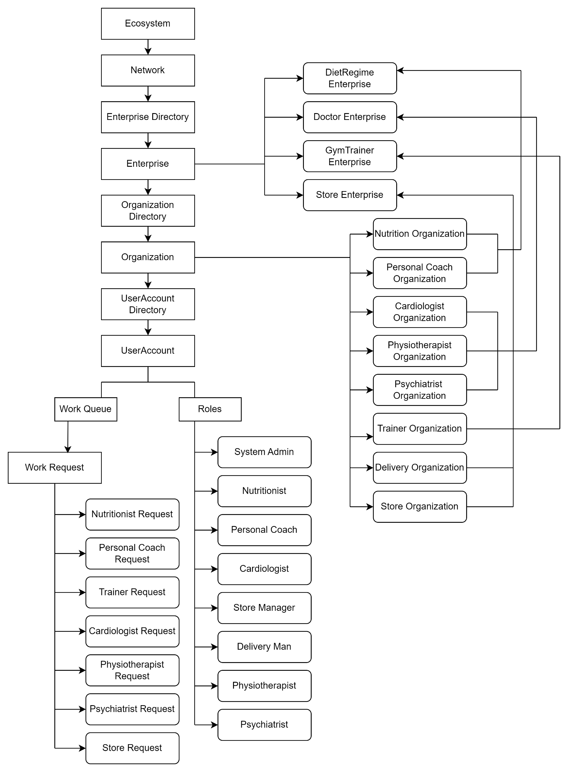
SYSTEM ARCHITECTURE DIAGRAM

Slide 6
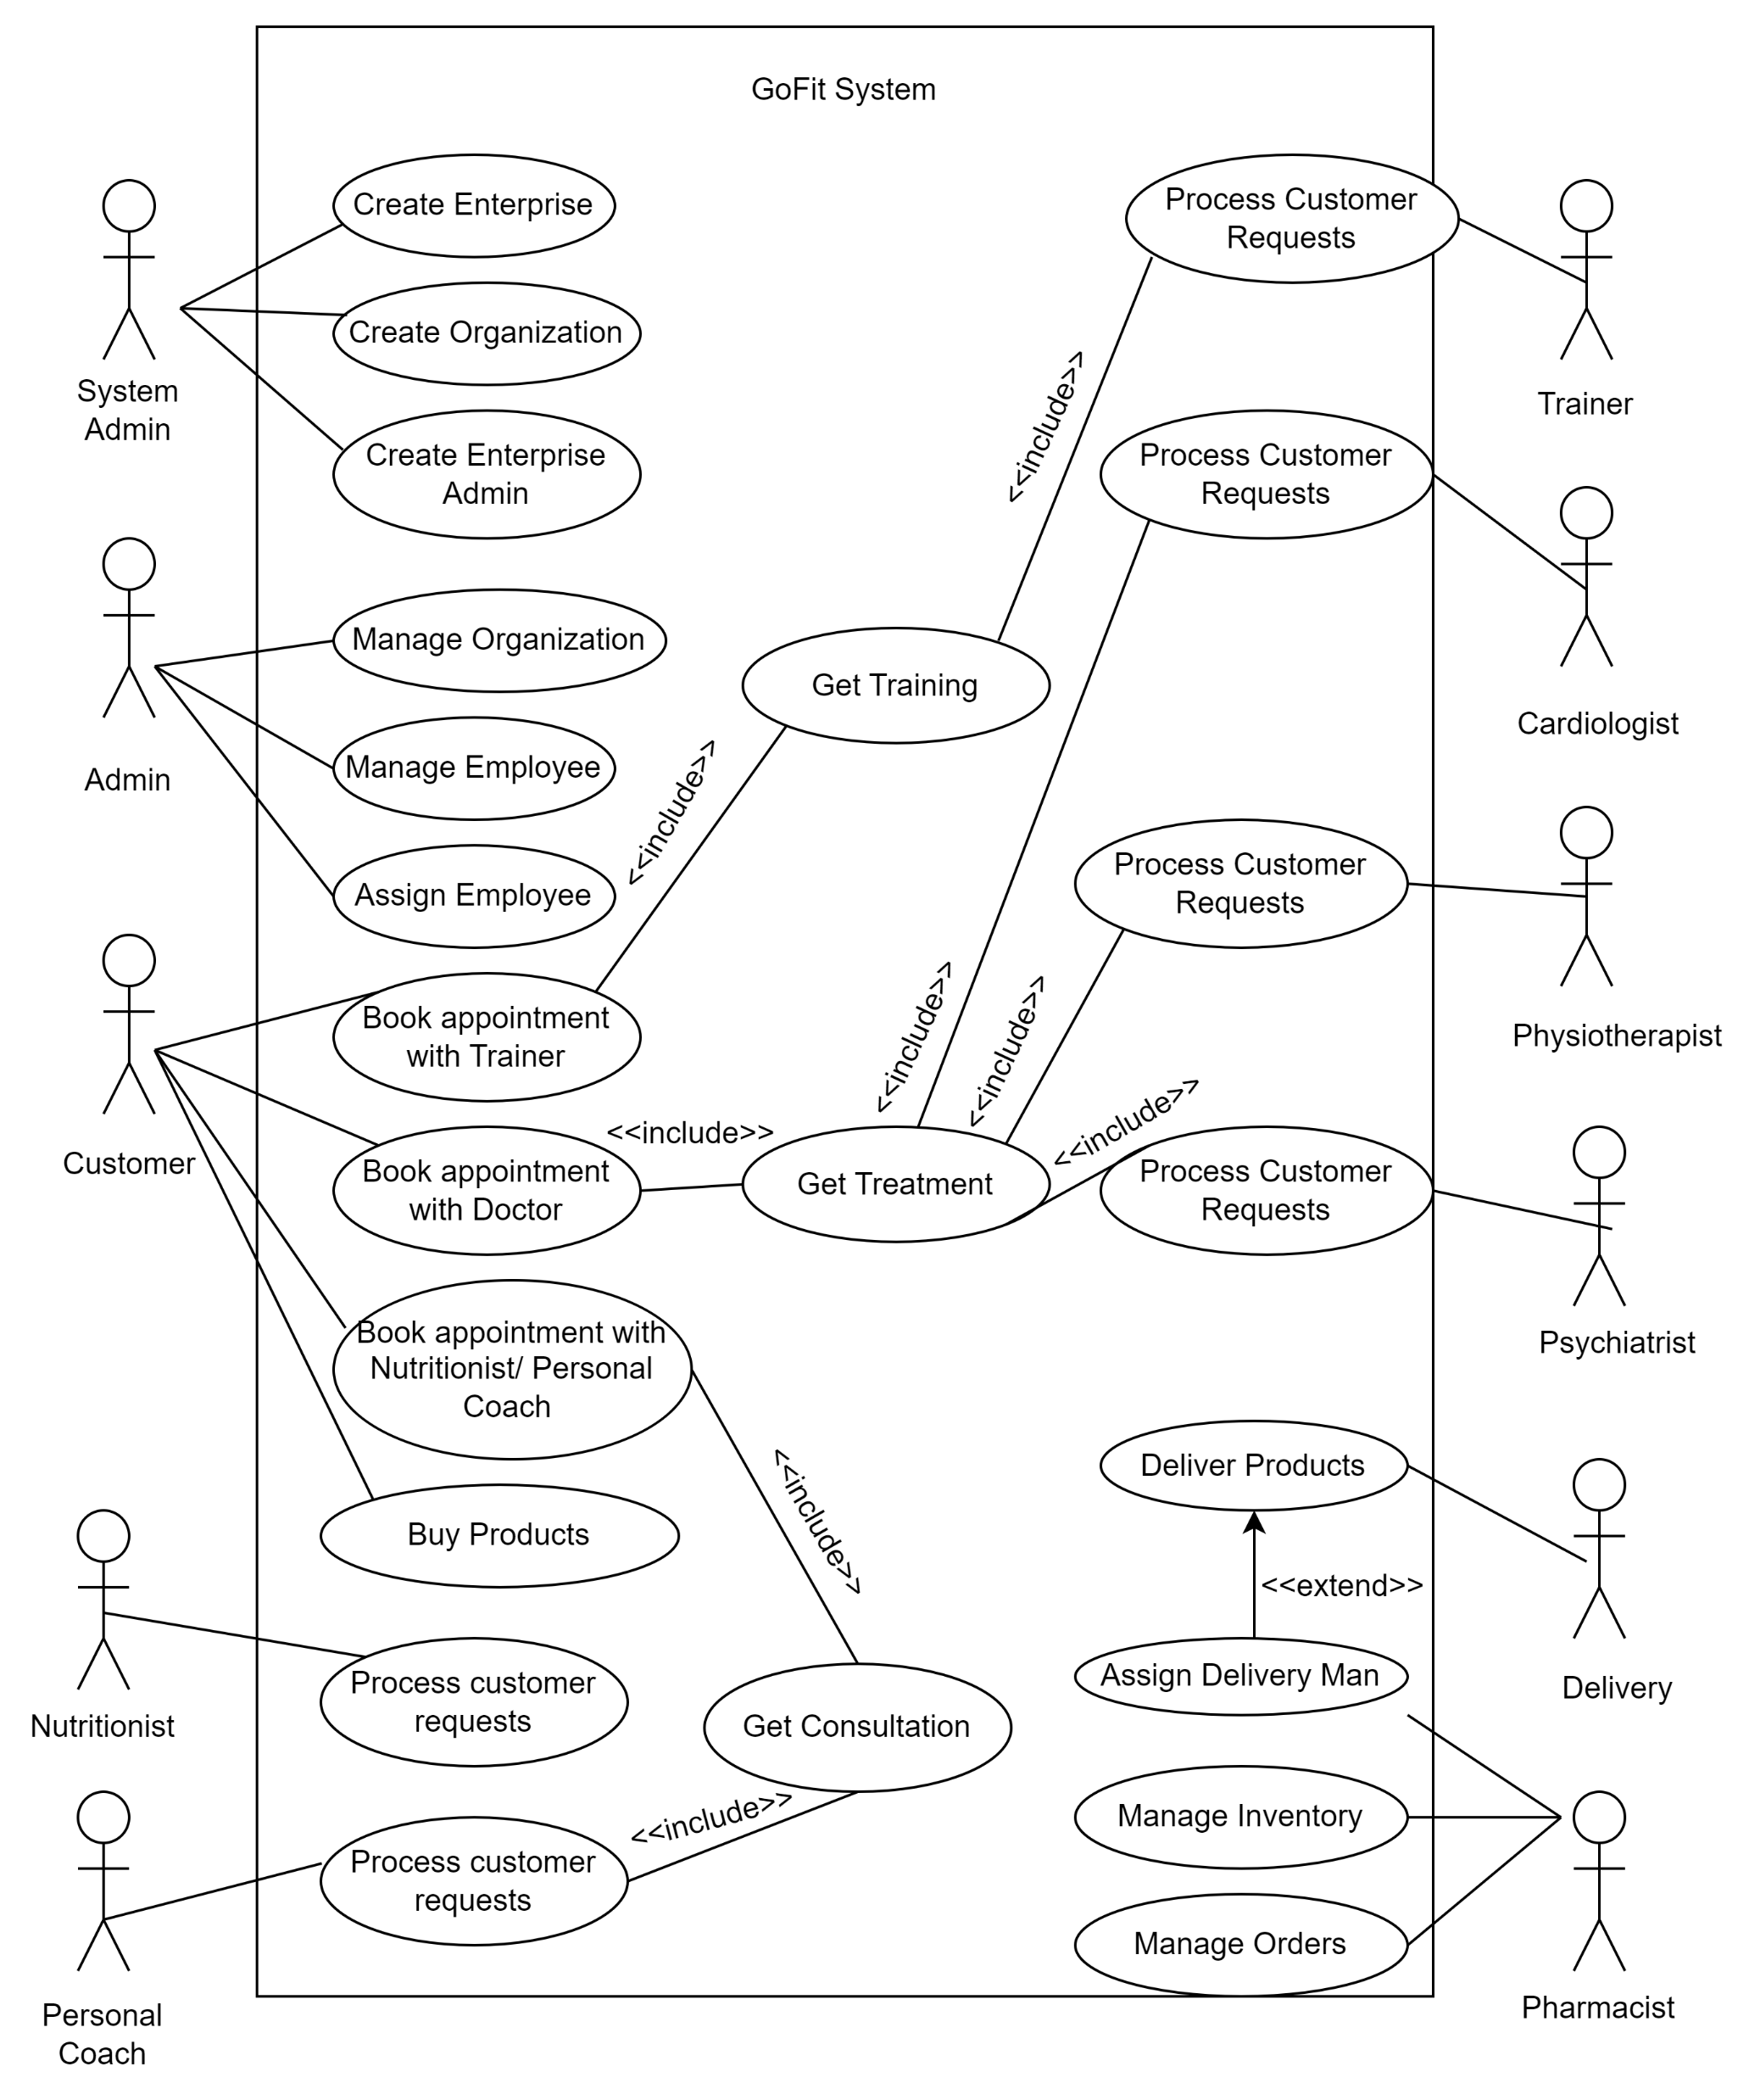
USE CASE DIAGRAM

Slide 7
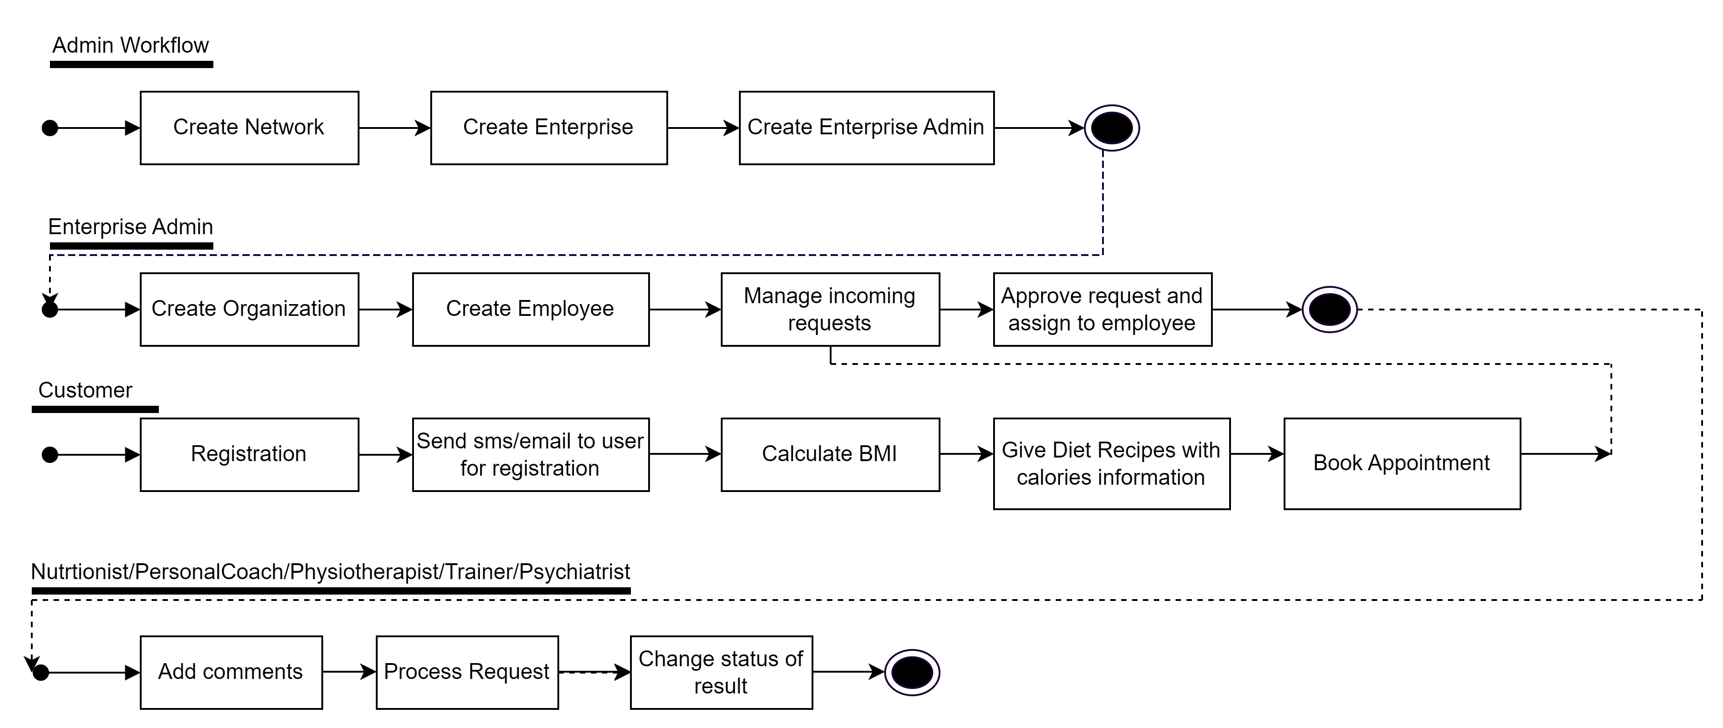
WORKFLOW DIAGRAM

Slide 8
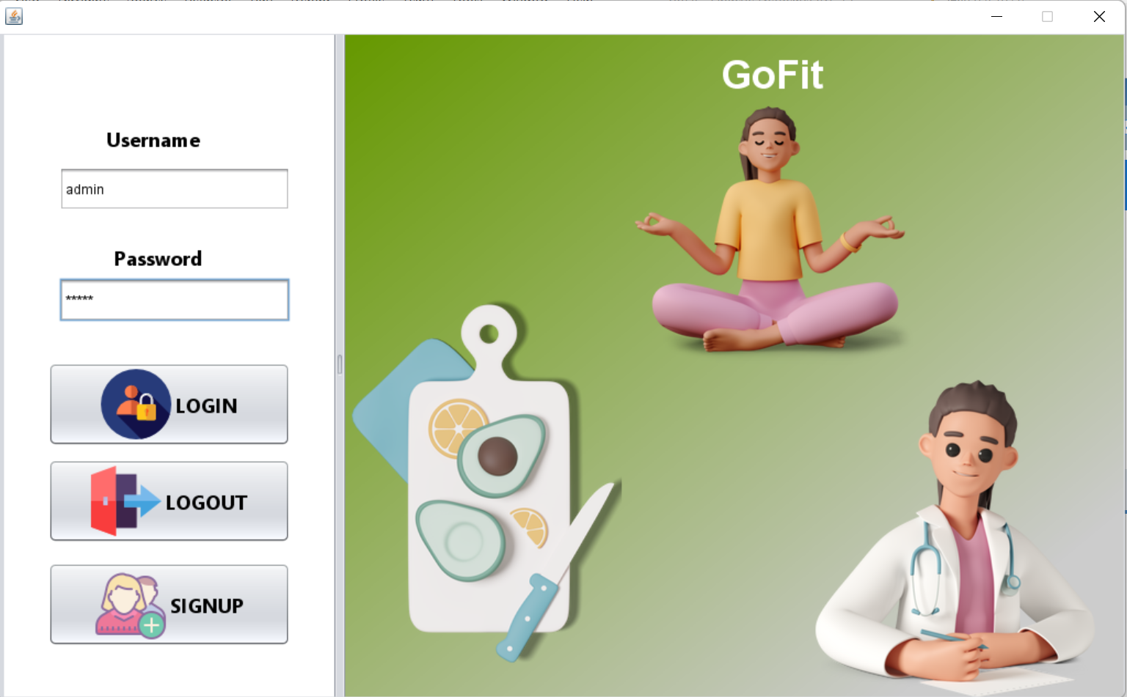

Slide 9
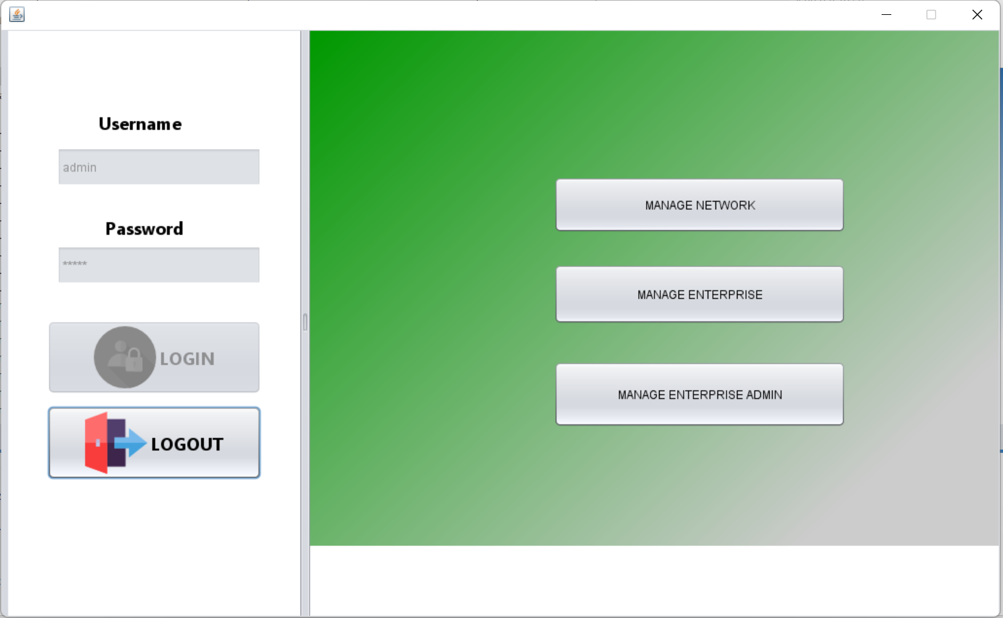

Slide 10
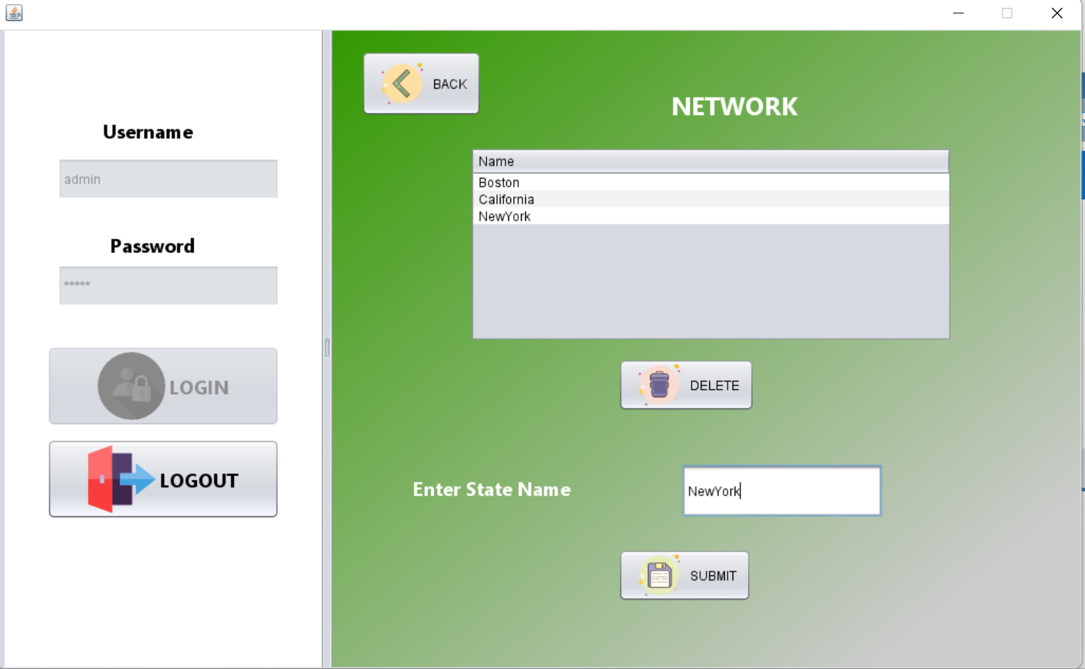

Slide 11
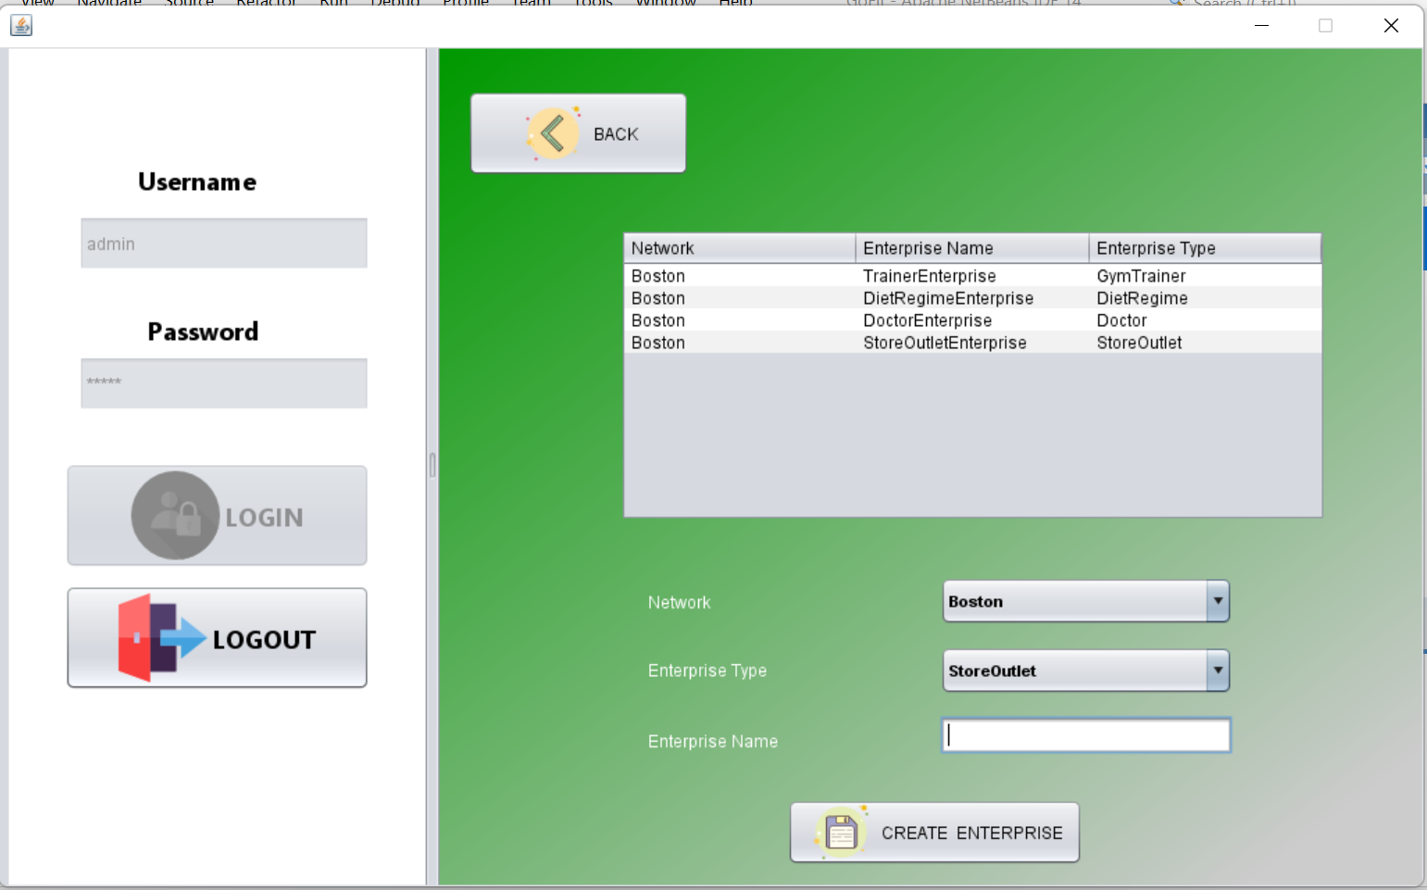

Slide 12
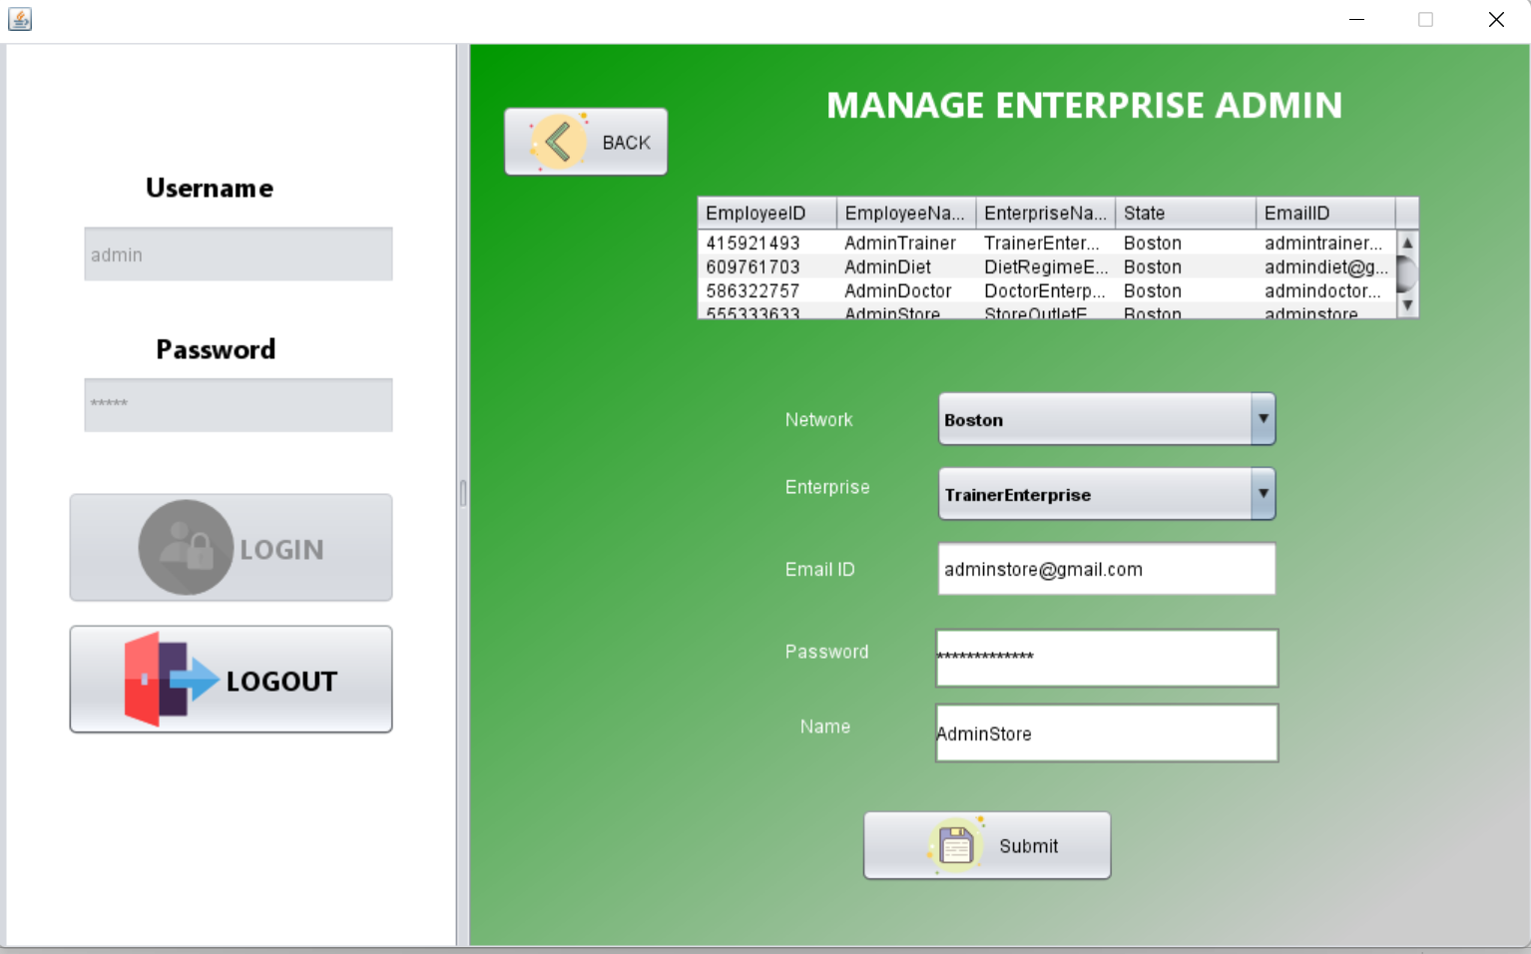

Slide 13
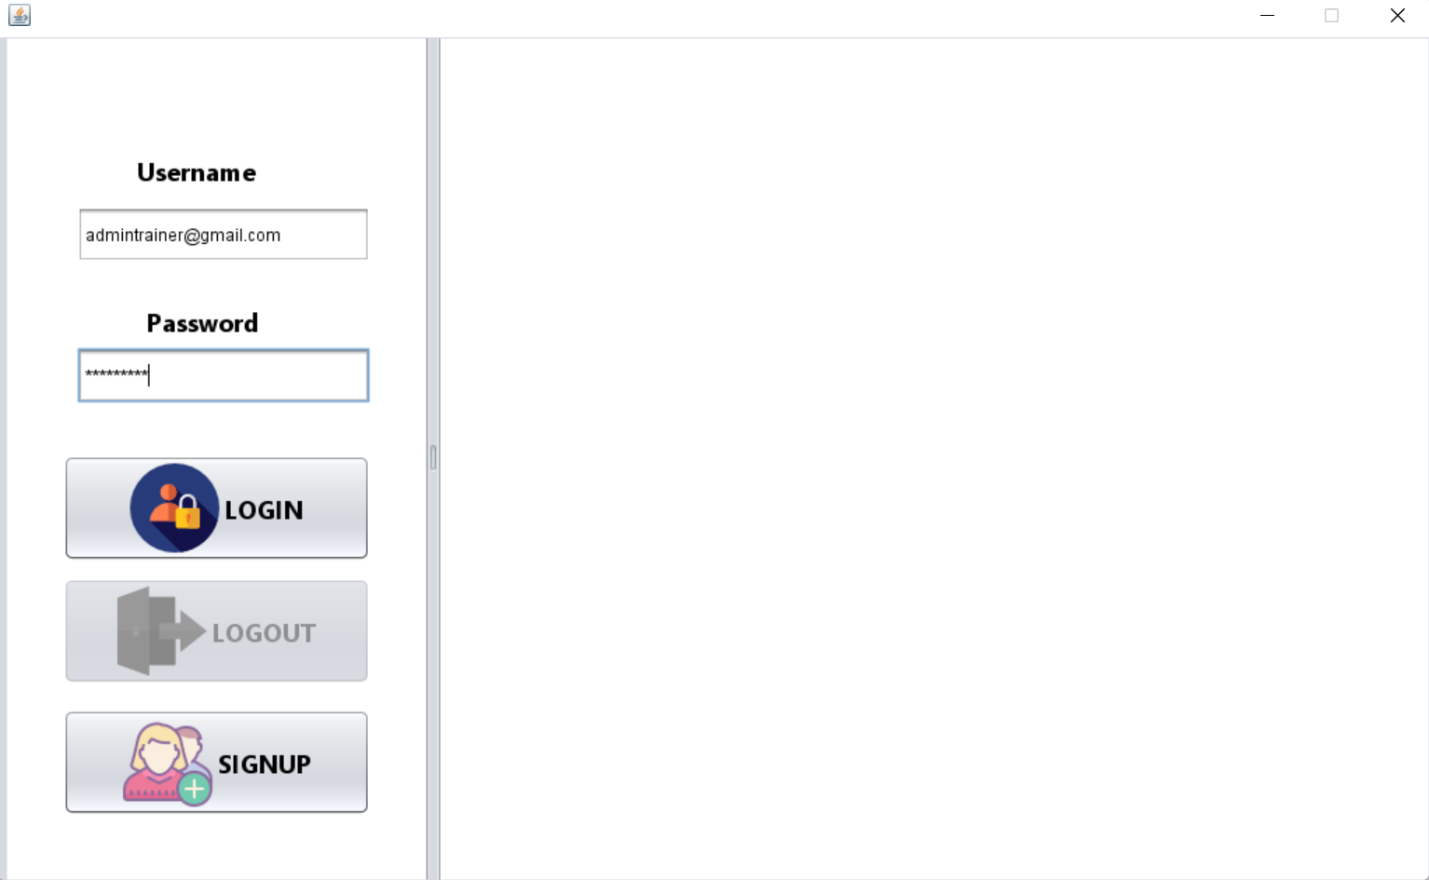

Slide 14
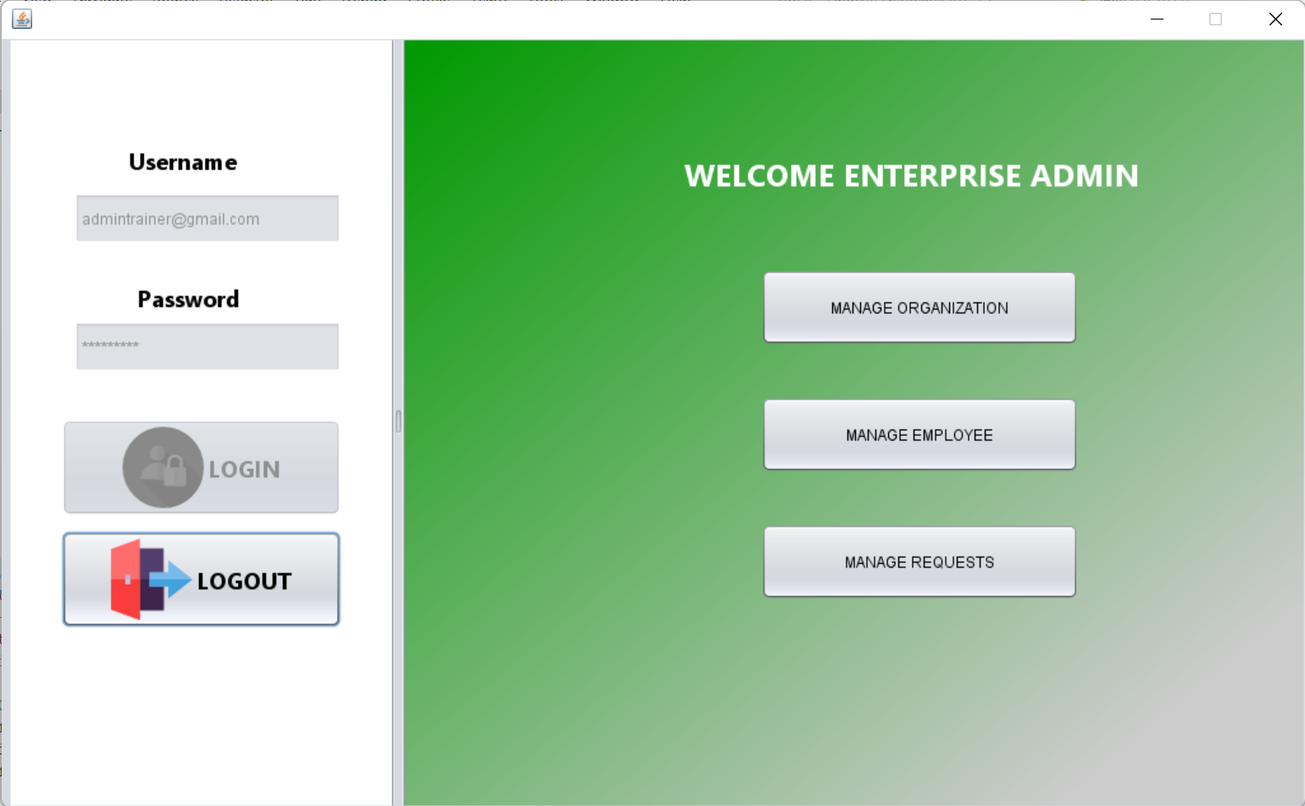

Slide 15
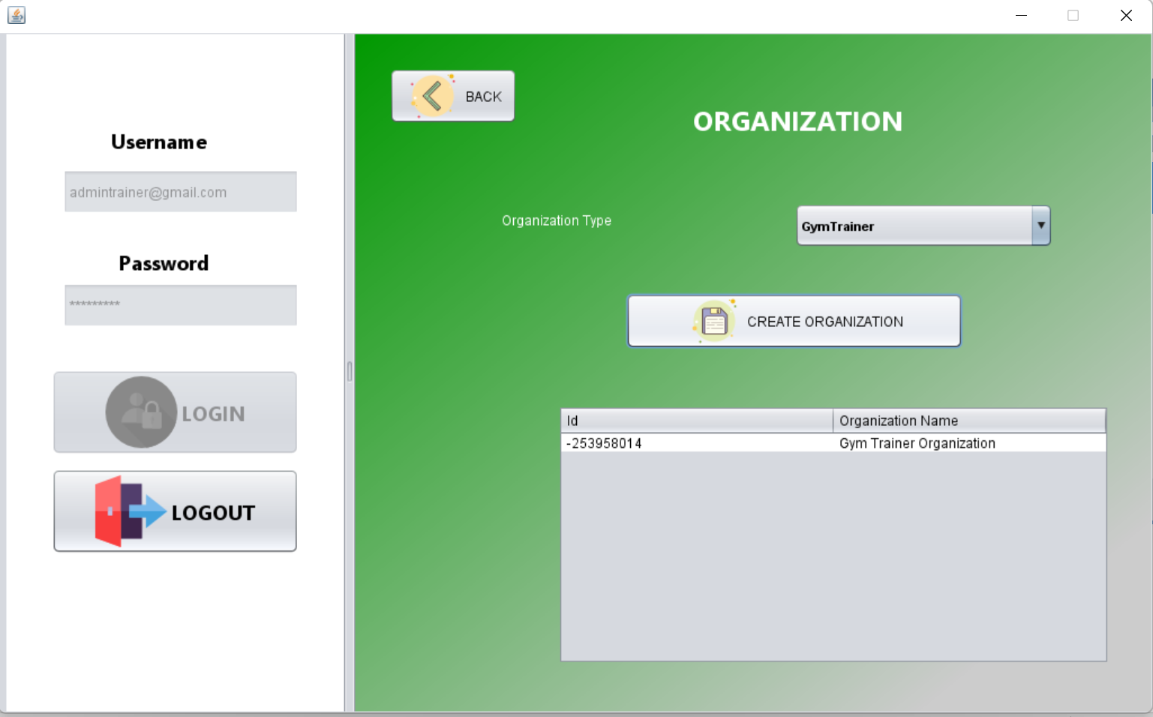

Slide 16
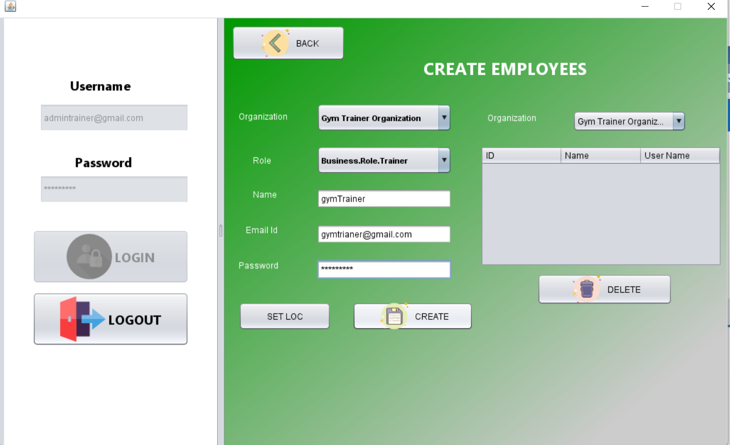

Slide 17
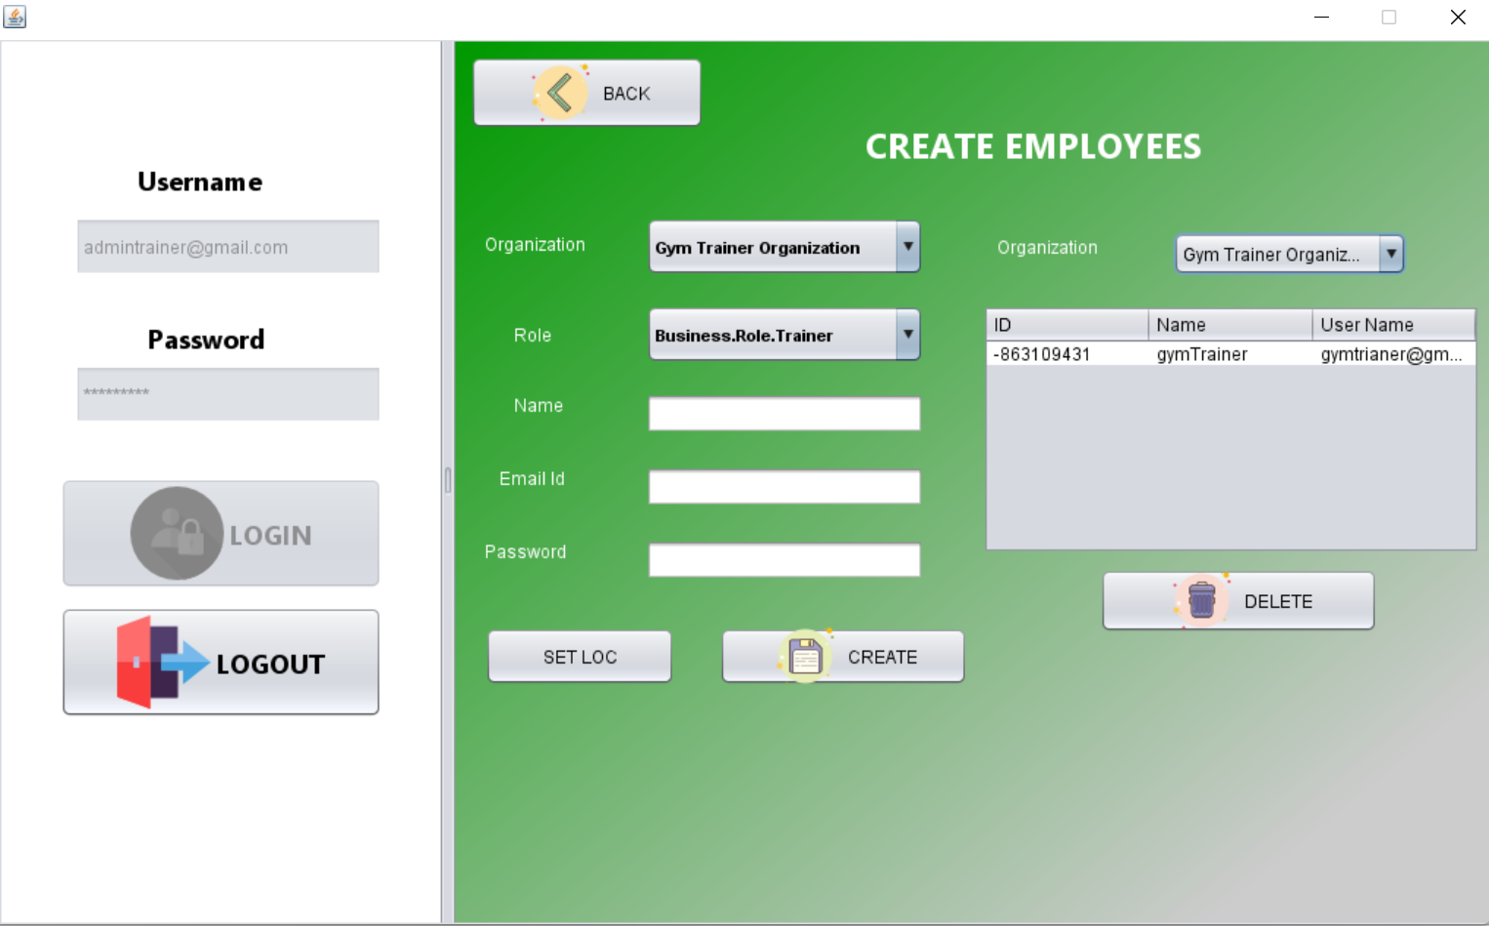

Slide 18
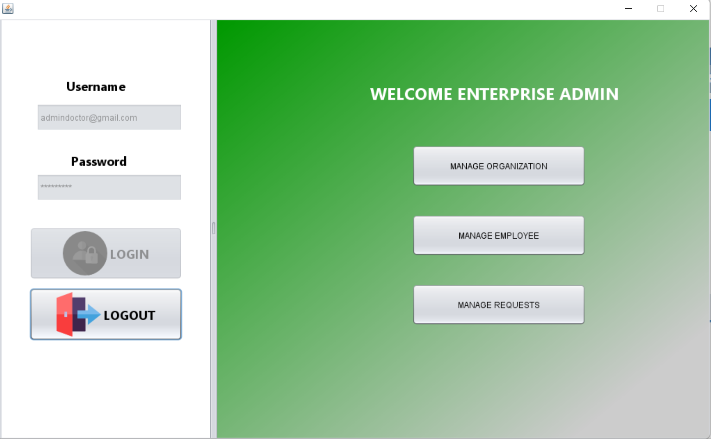

Slide 19
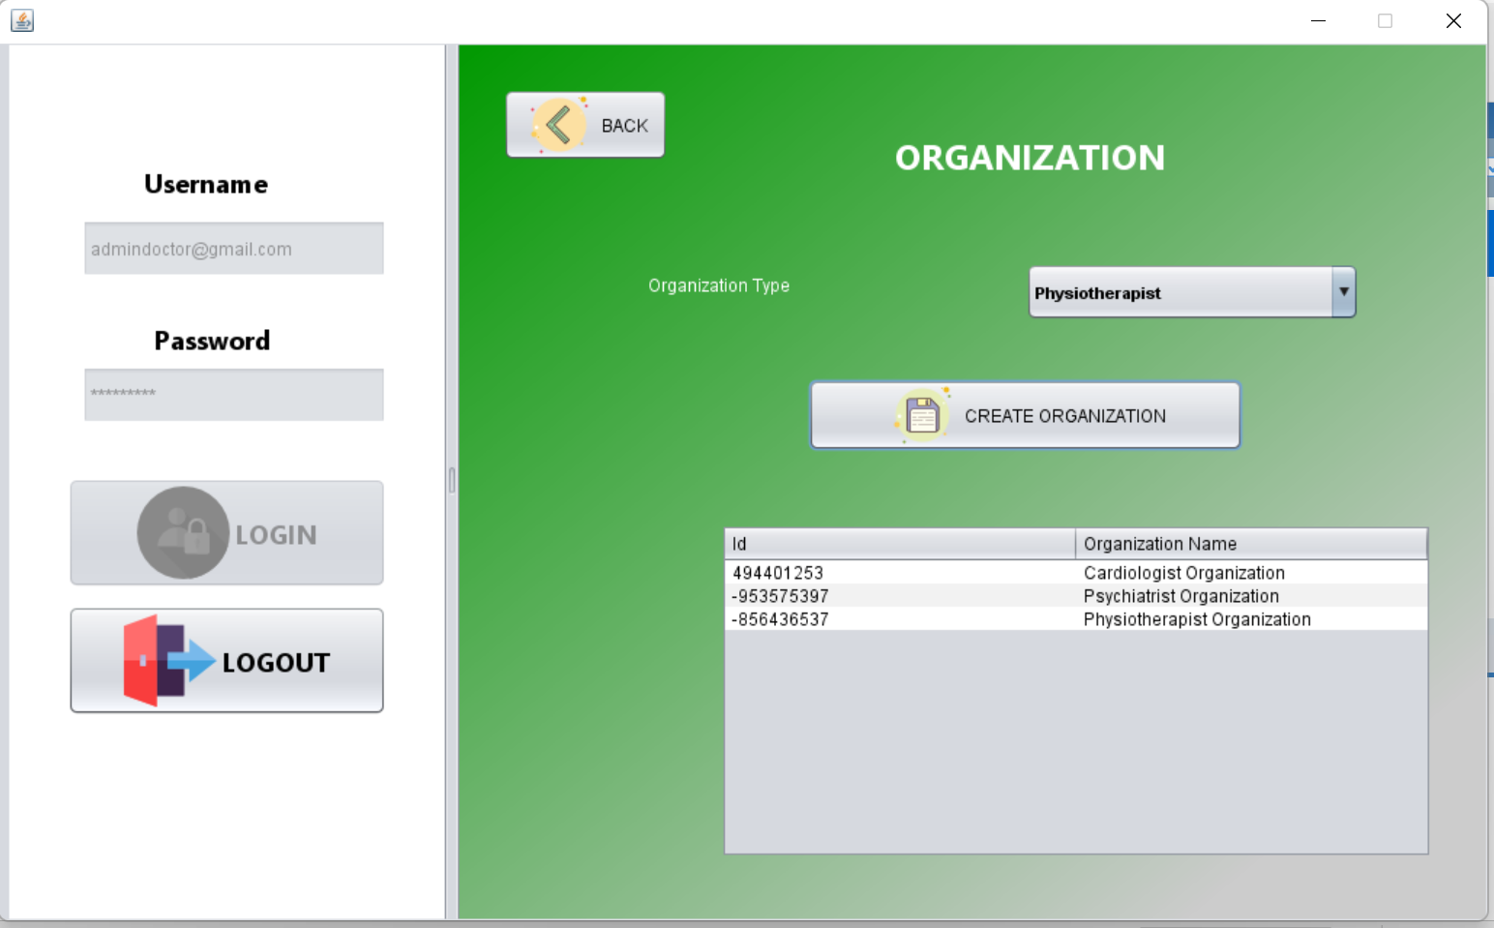

Slide 20
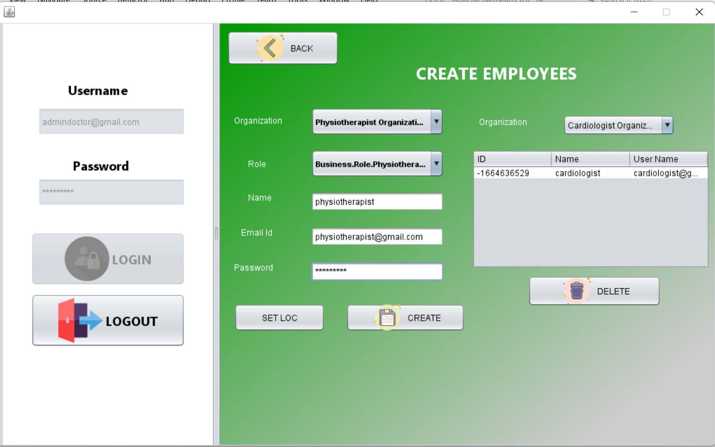
s

Slide 21
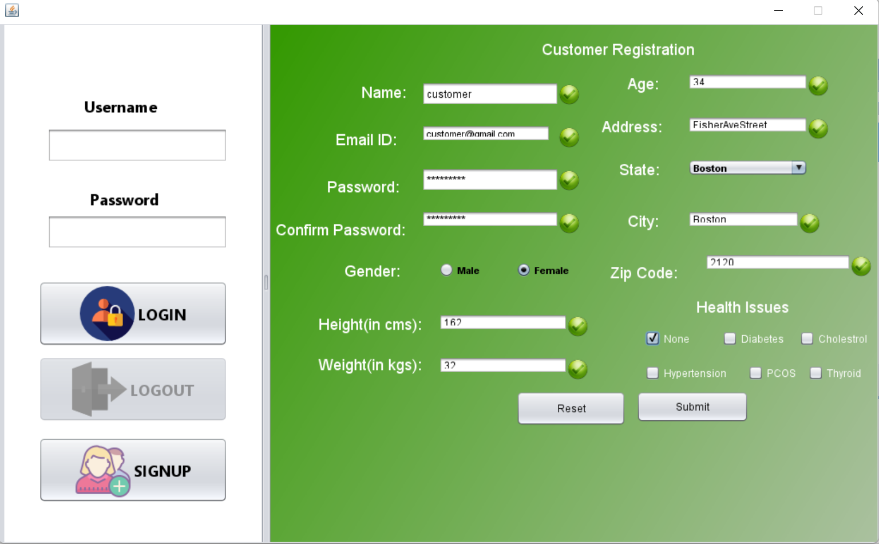

Slide 22
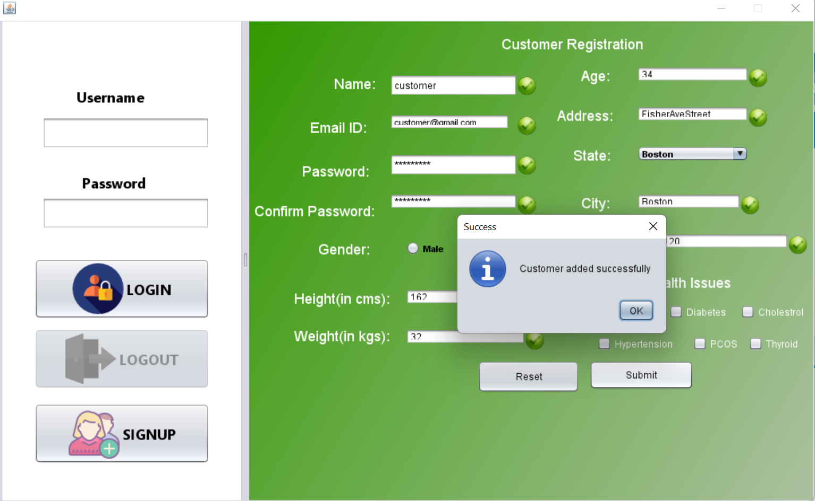

Slide 23
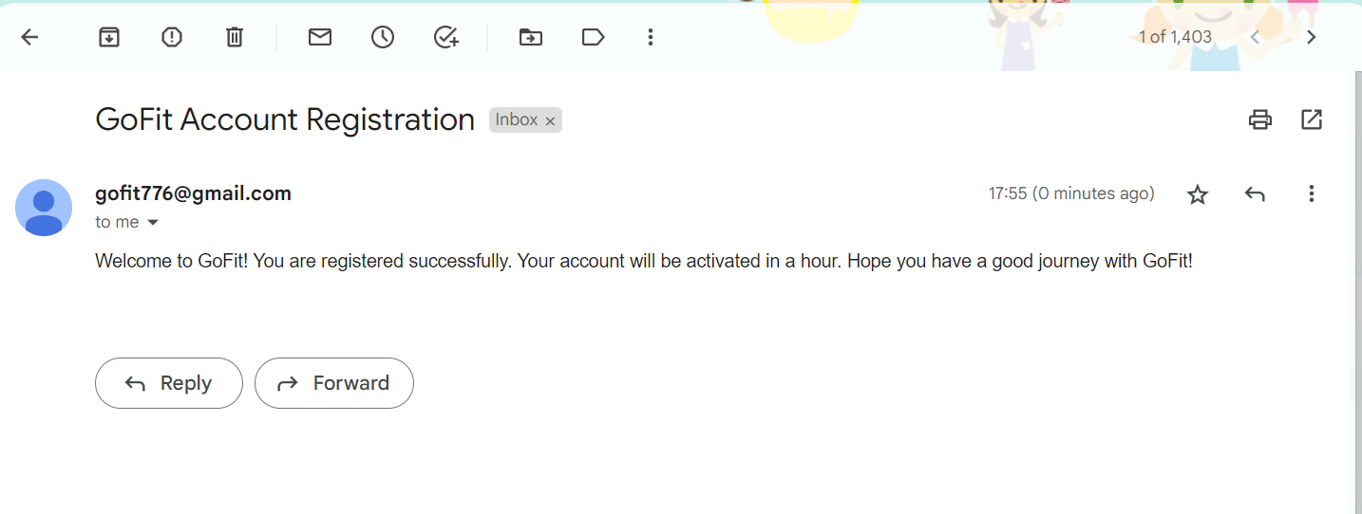

Slide 24
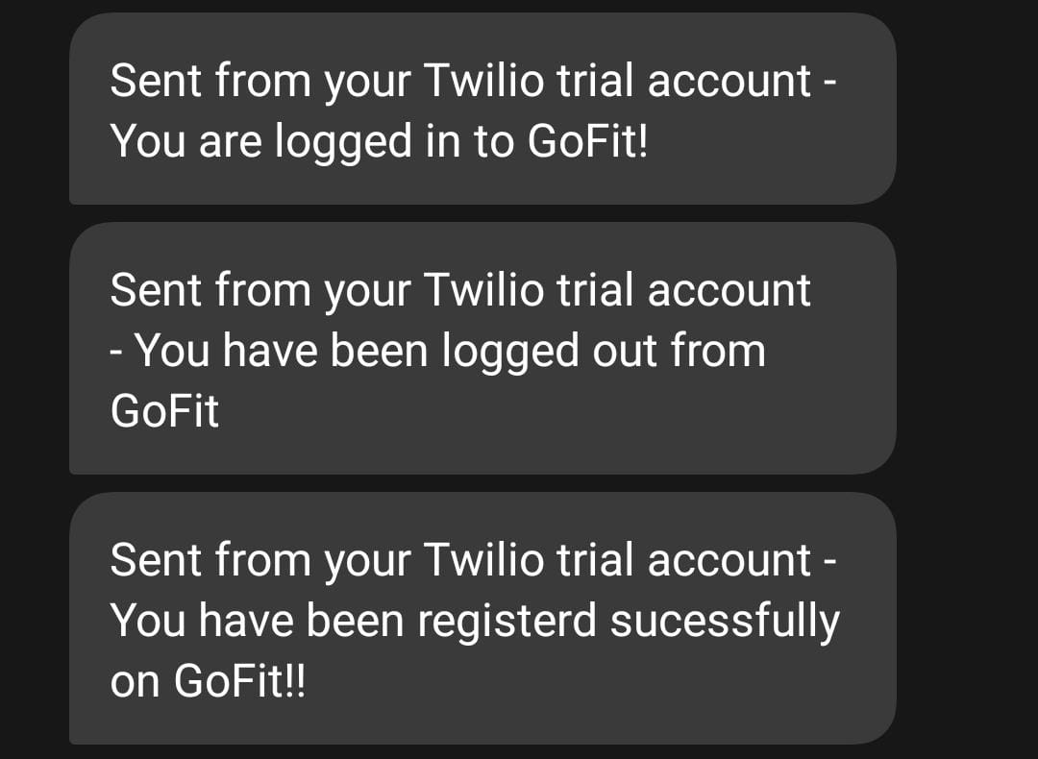

Slide 25
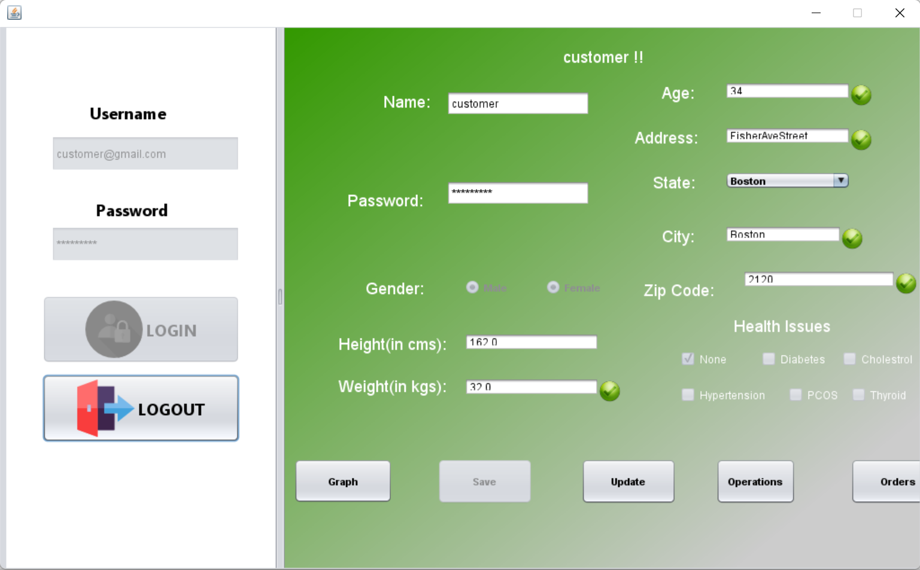

Slide 26
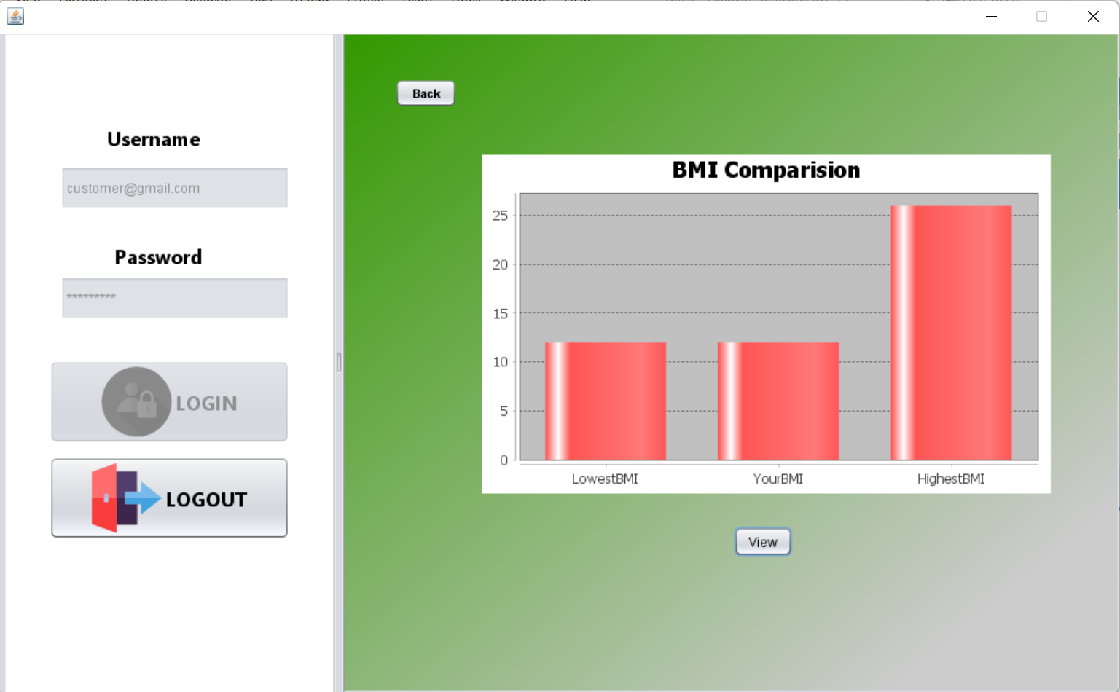

Slide 27
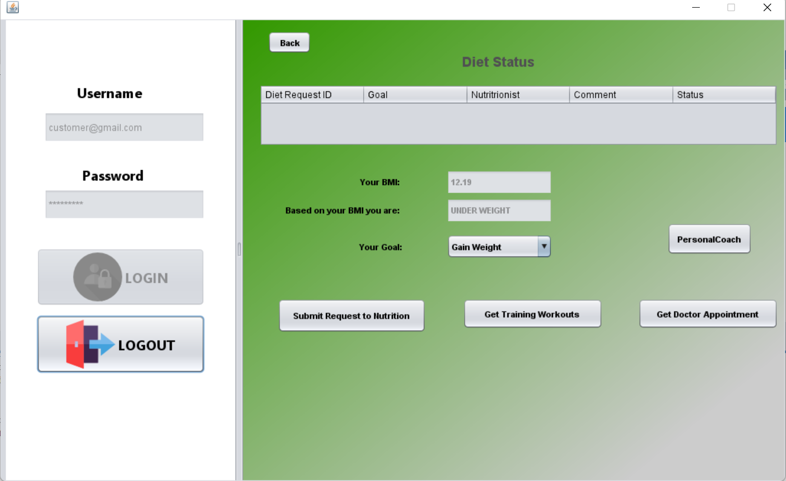

Slide 28
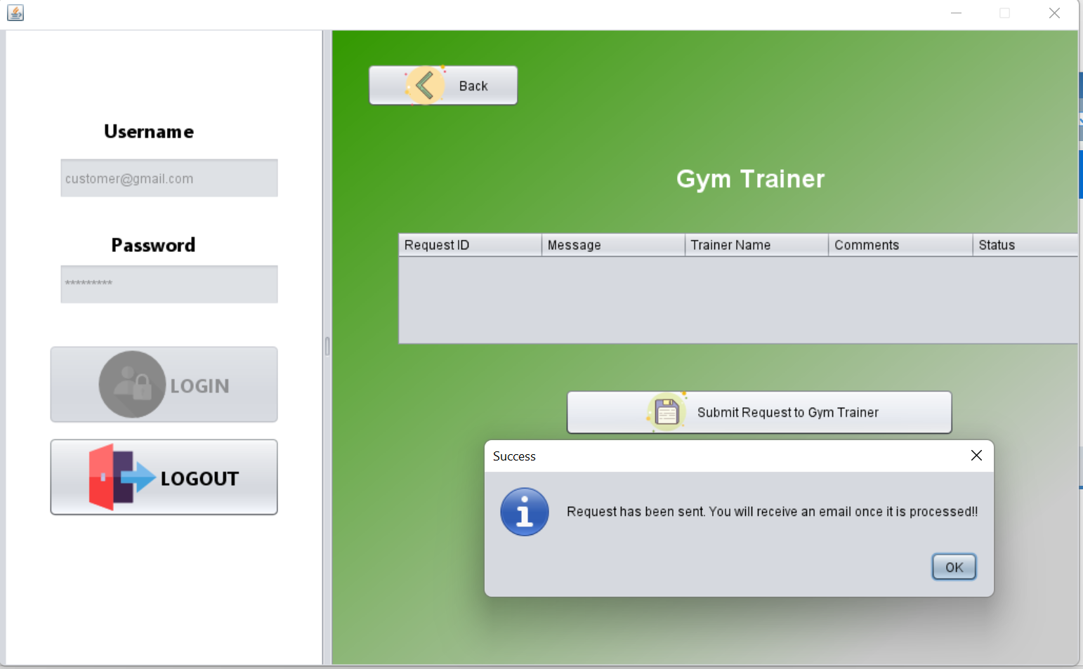

Slide 29
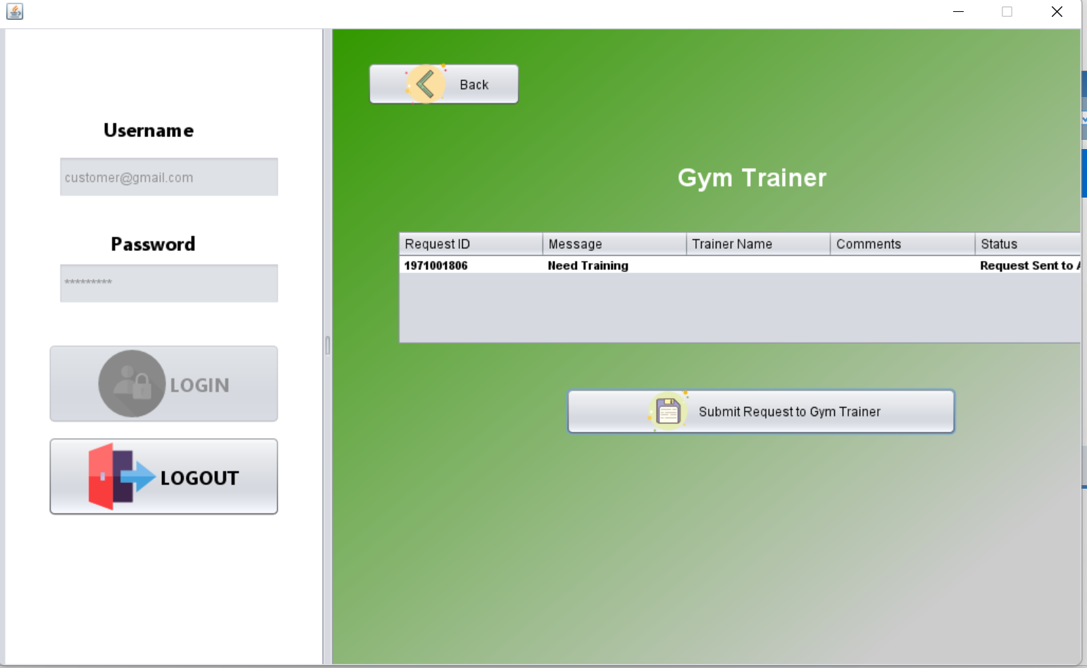

Slide 30
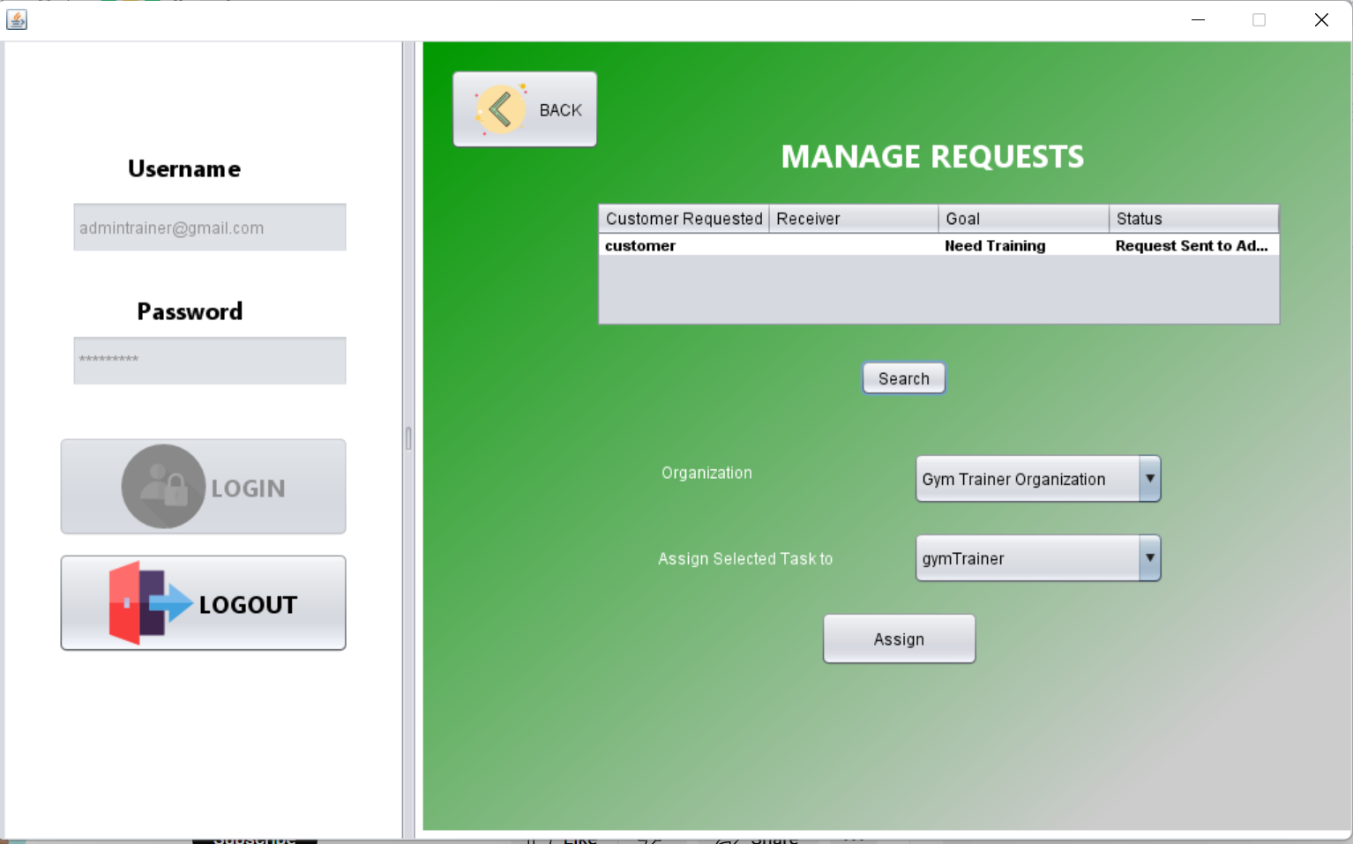

Slide 31
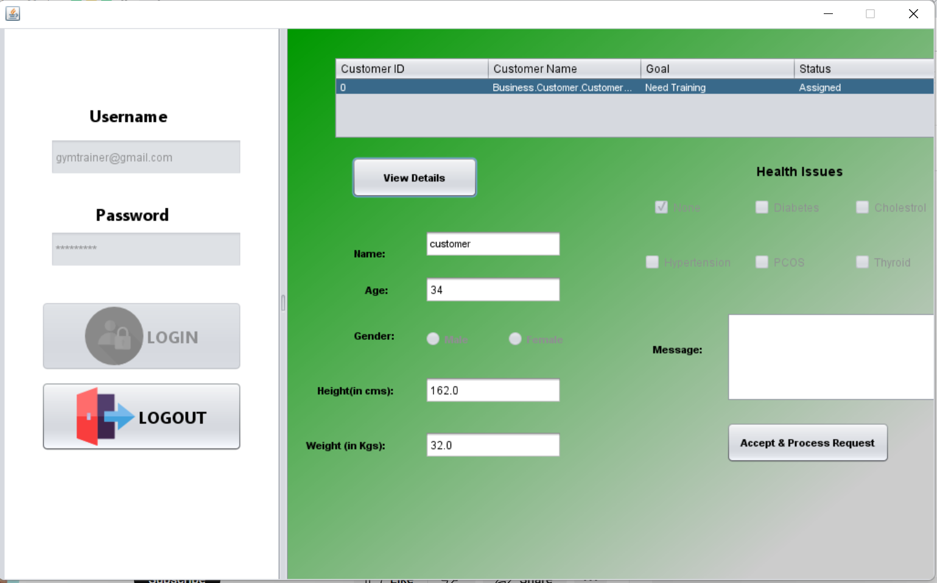

Slide 32
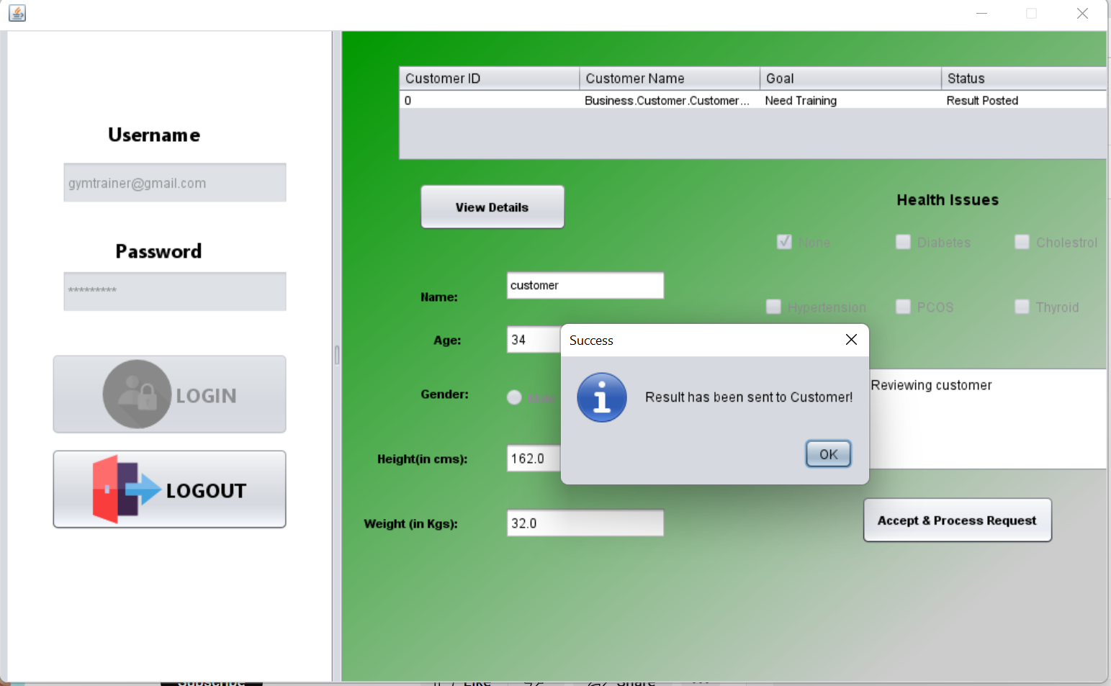

Slide 33
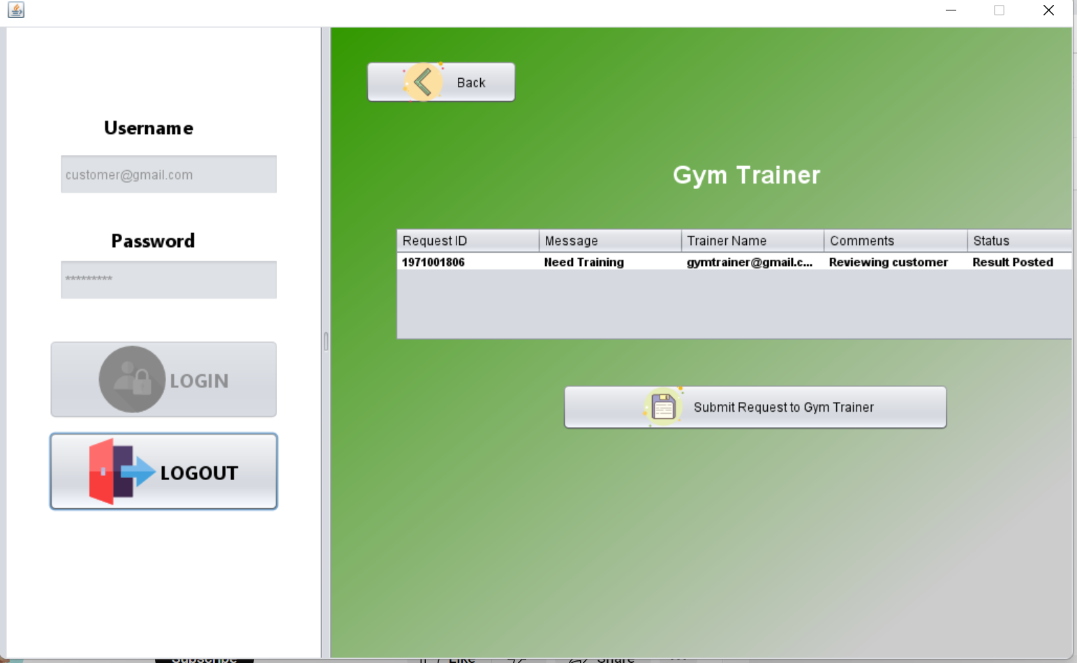

Slide 34
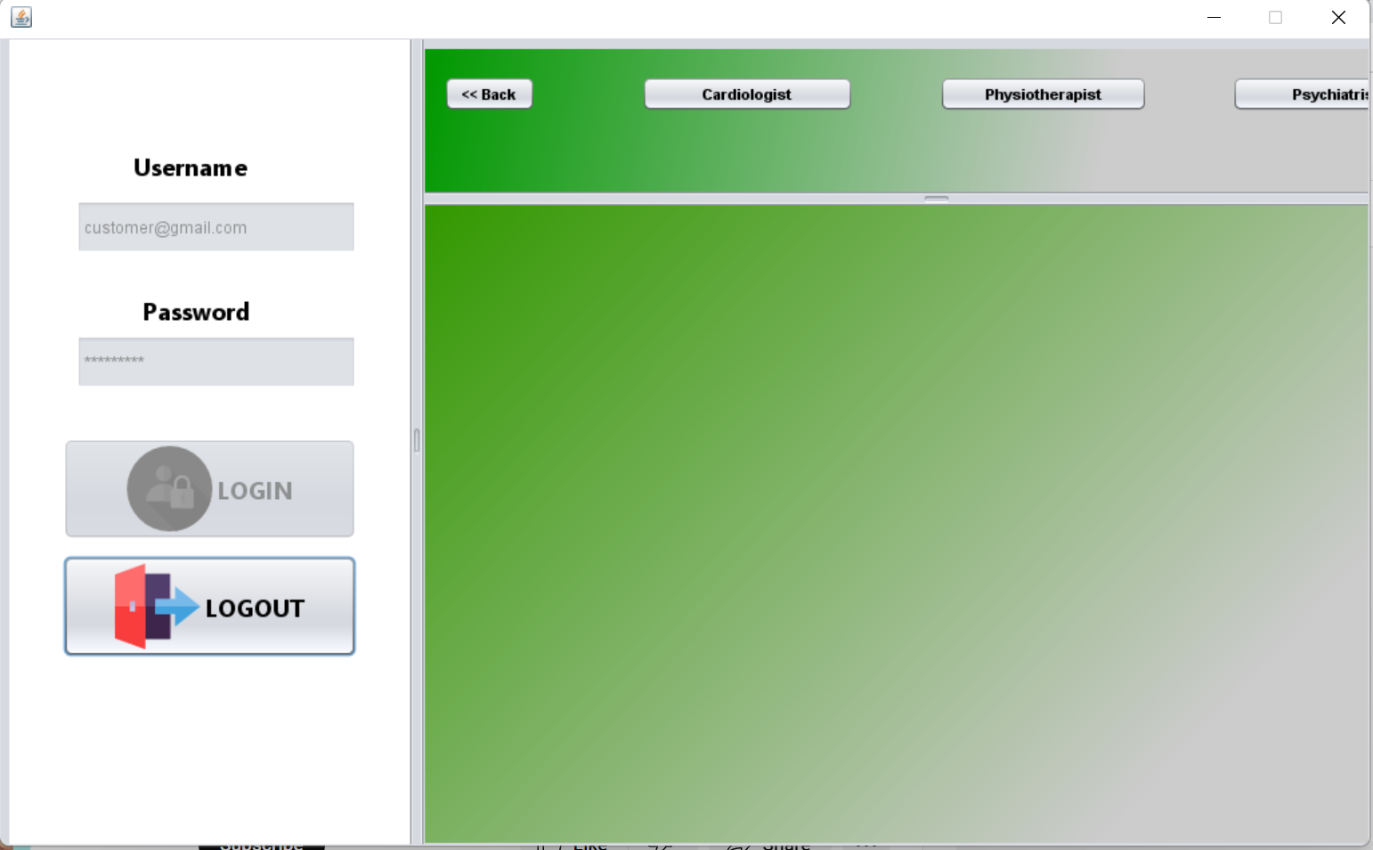

Slide 35
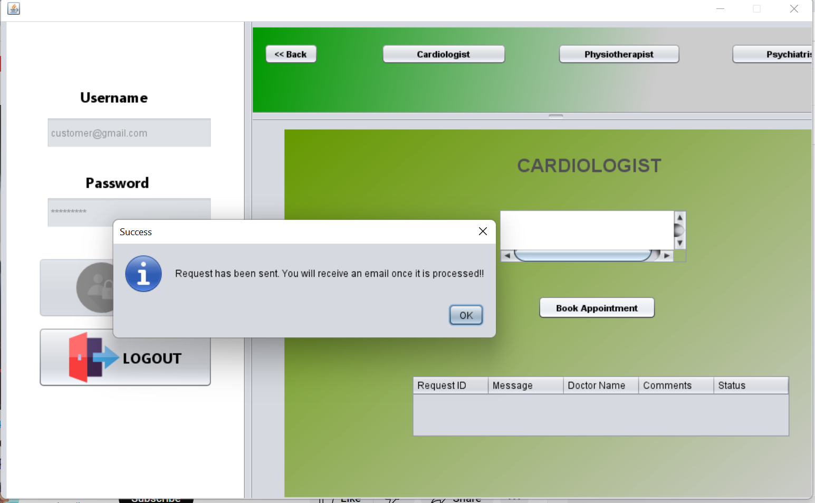

Slide 36
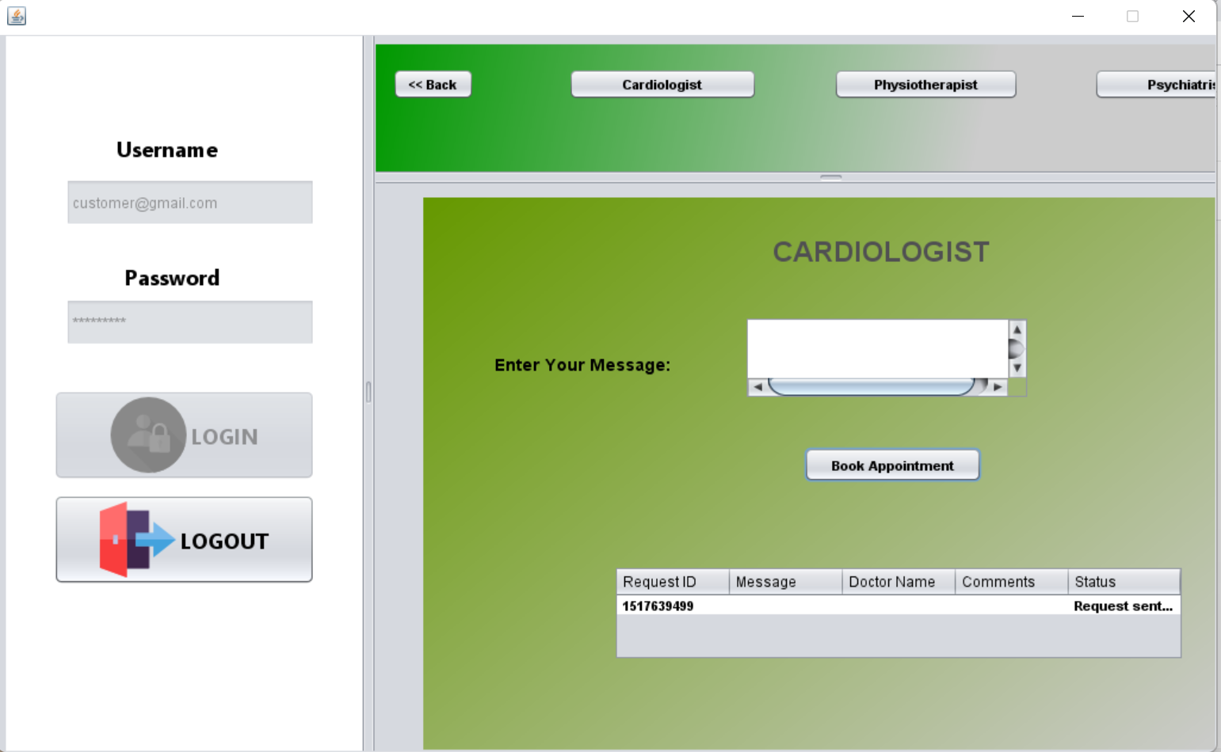

Slide 37
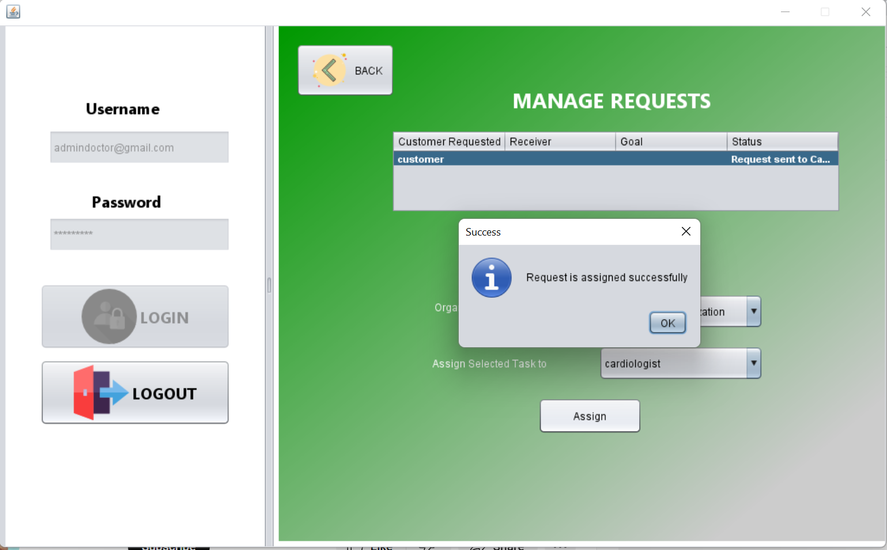

Slide 38
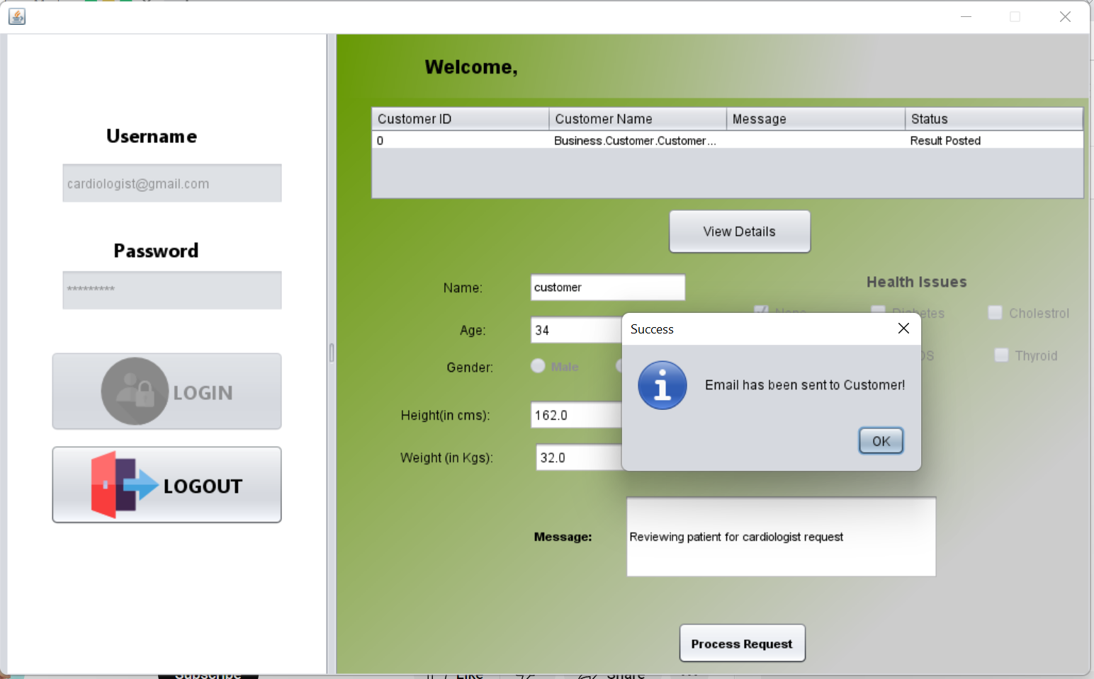

Slide 39
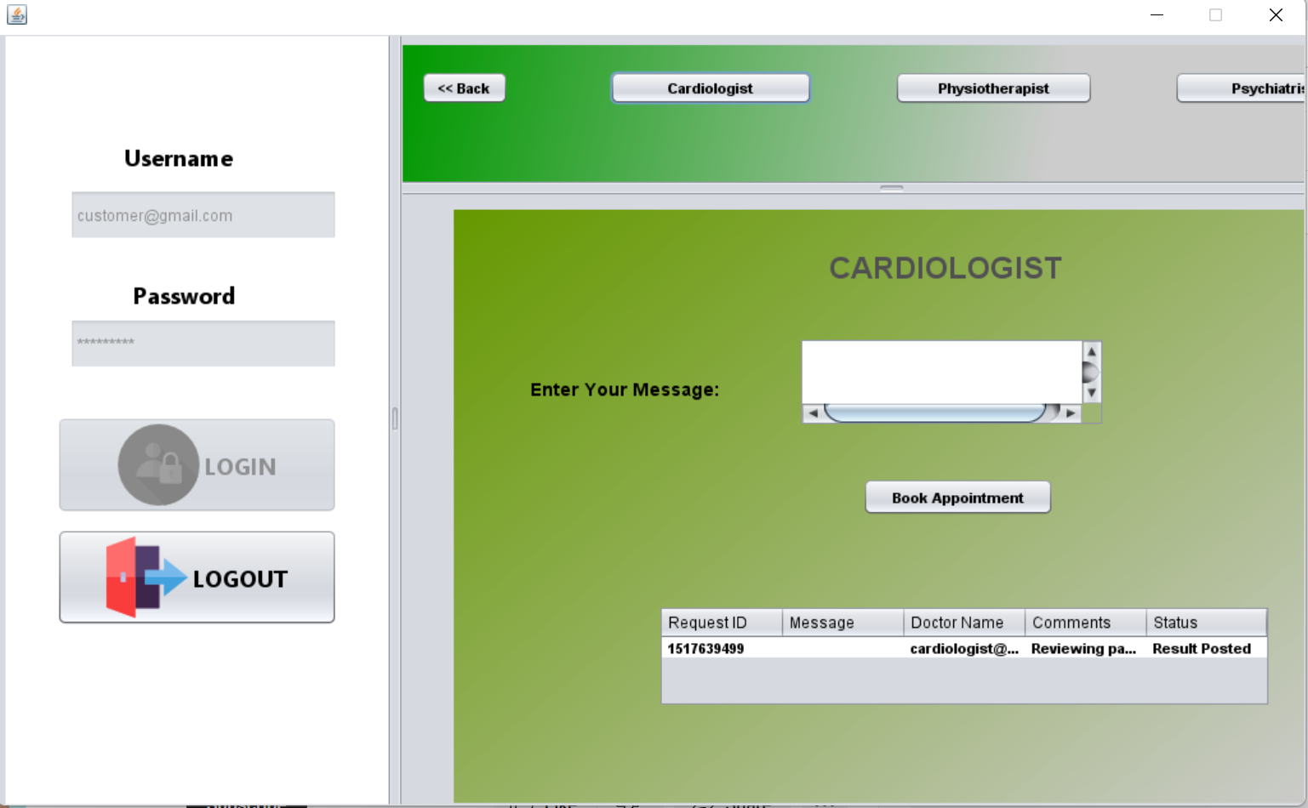

Slide 40
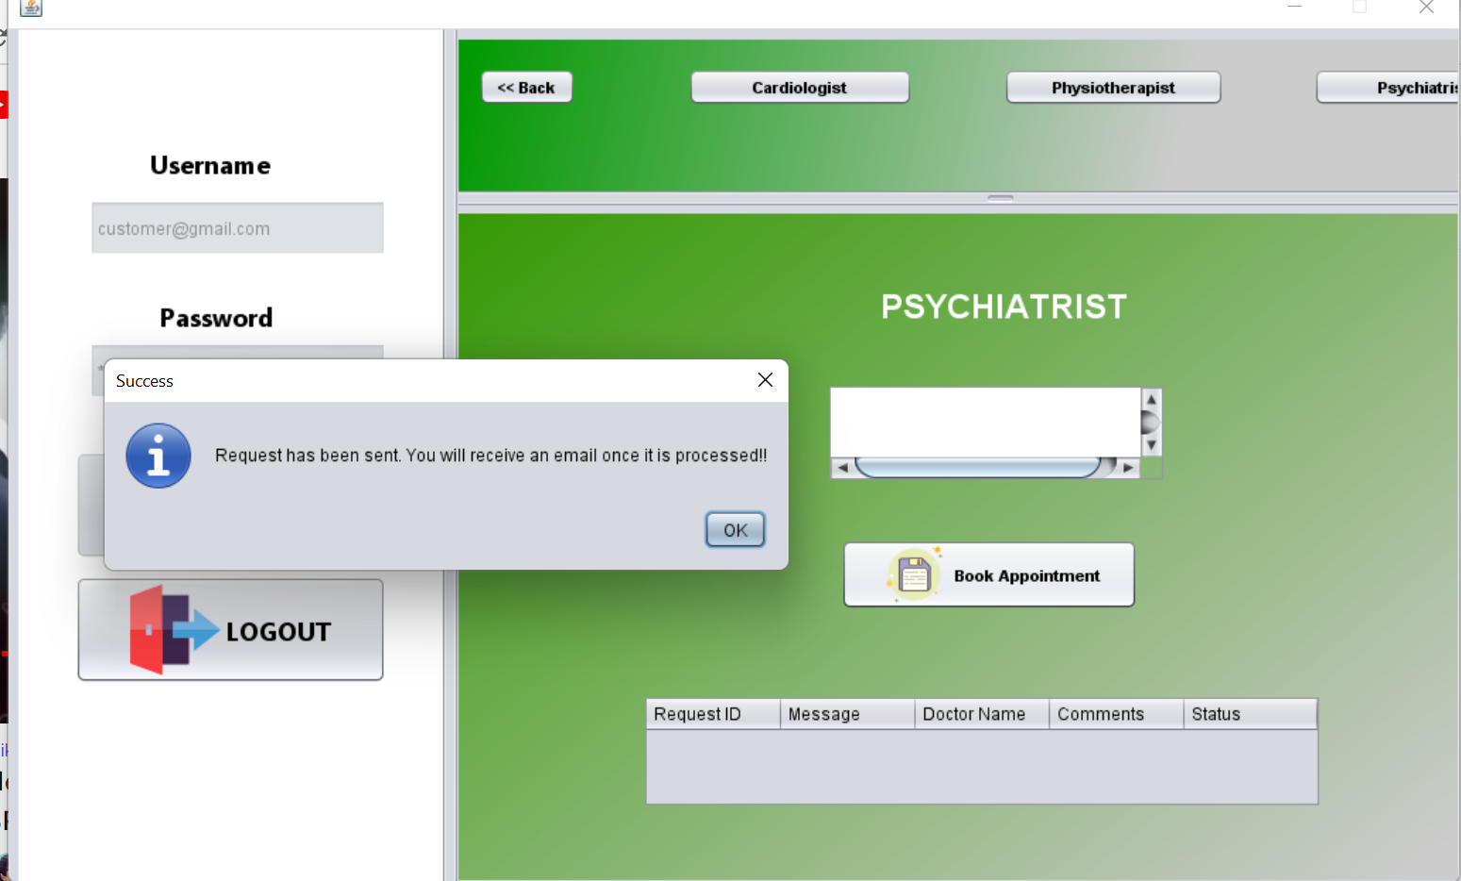

Slide 41
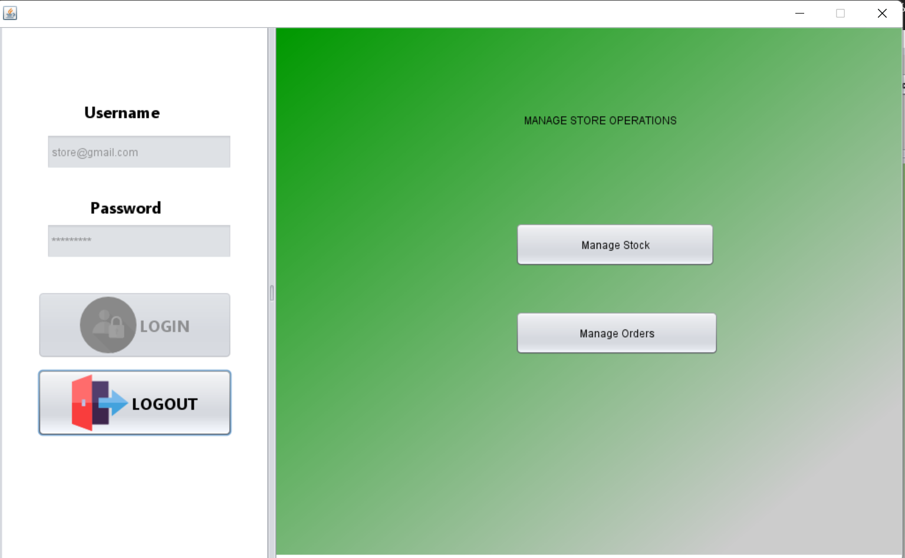

Slide 42
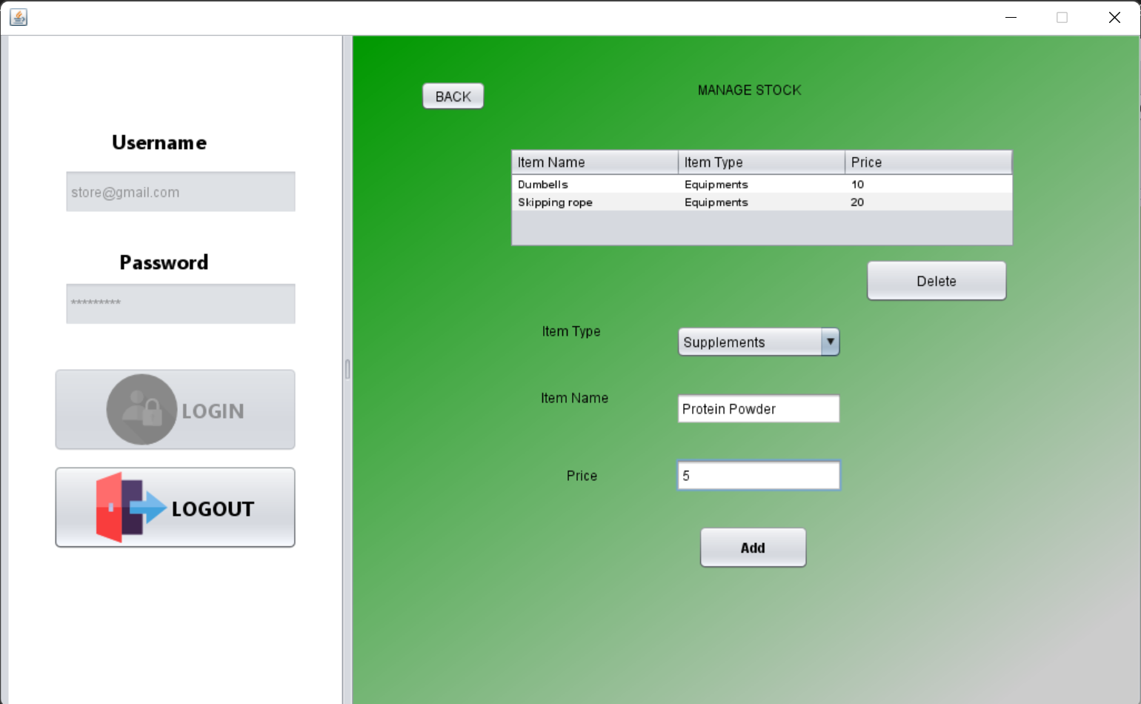

Slide 43
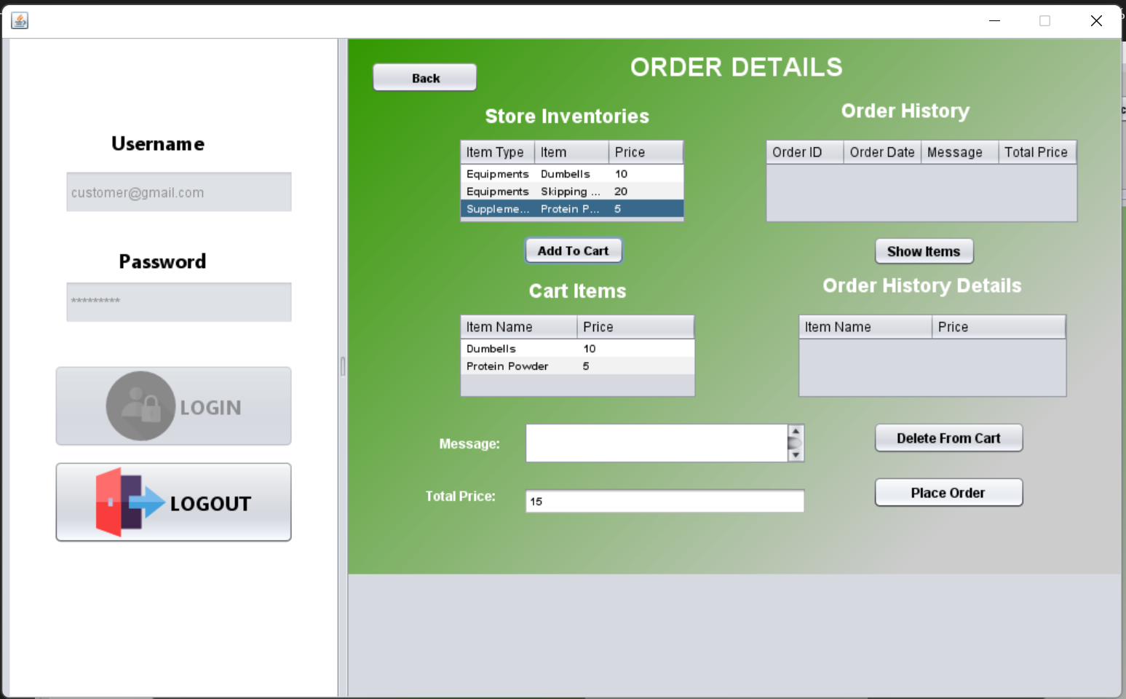

Slide 44
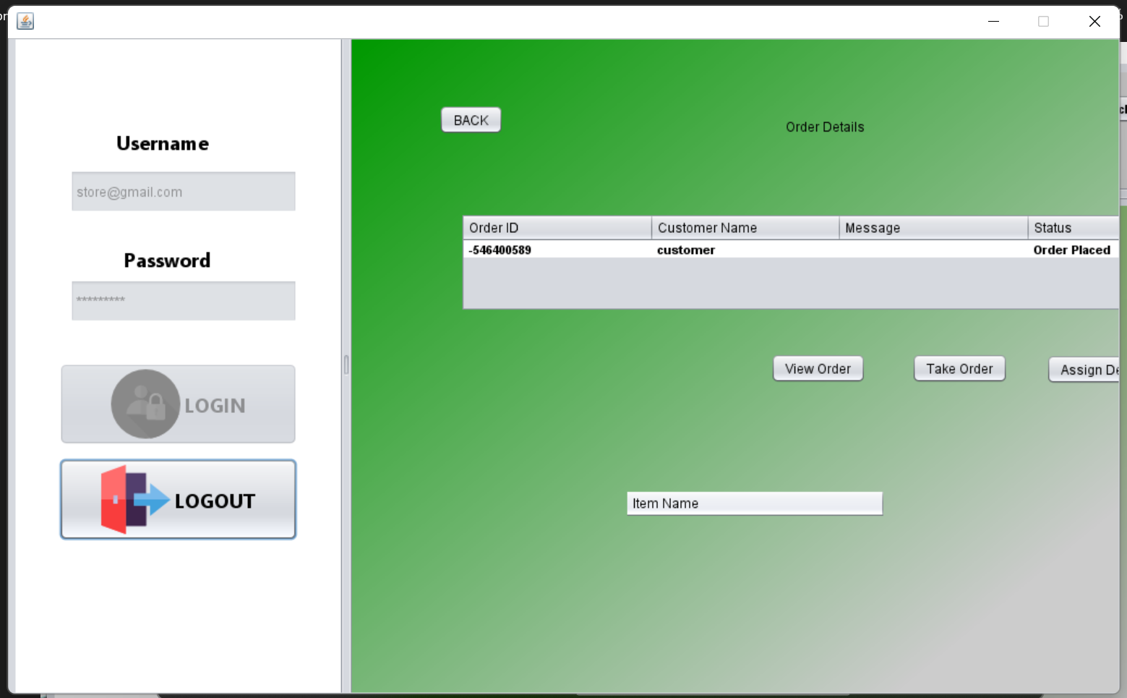

Slide 45
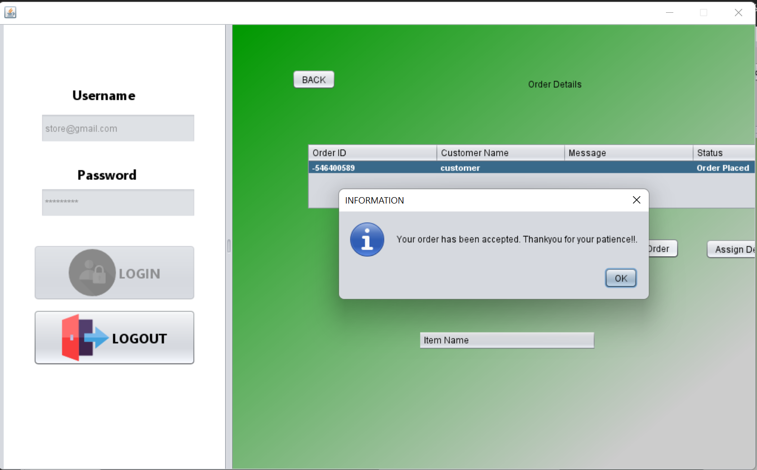

Slide 46
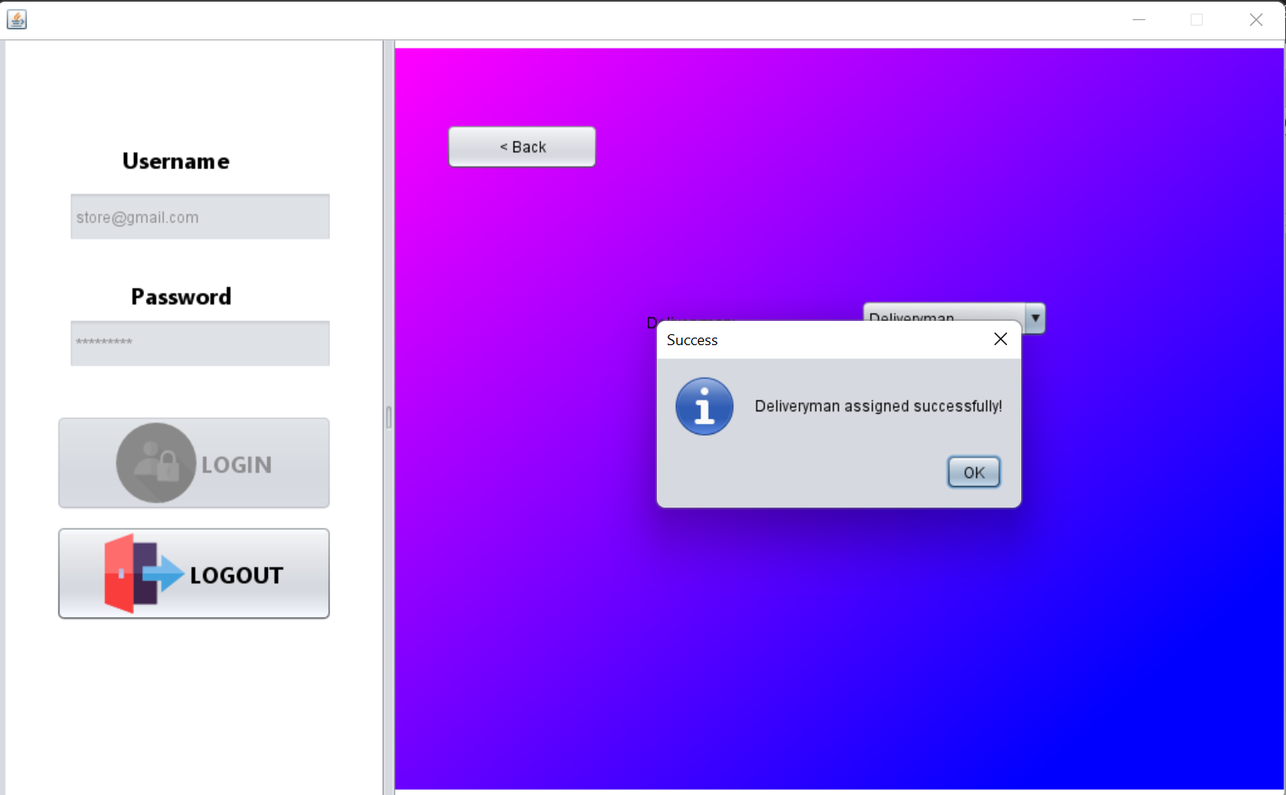

Slide 47
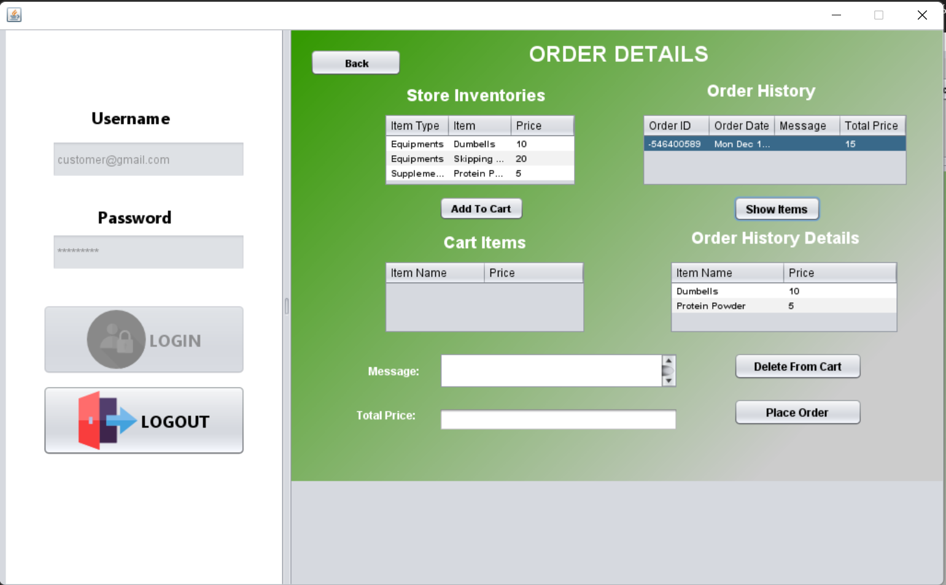

Slide 48
THANKS

